Slide 1
Between Skepticism and Mysticism
An Introduction to the Occult Philosophy of Cornelius Agrippa

Slide 2
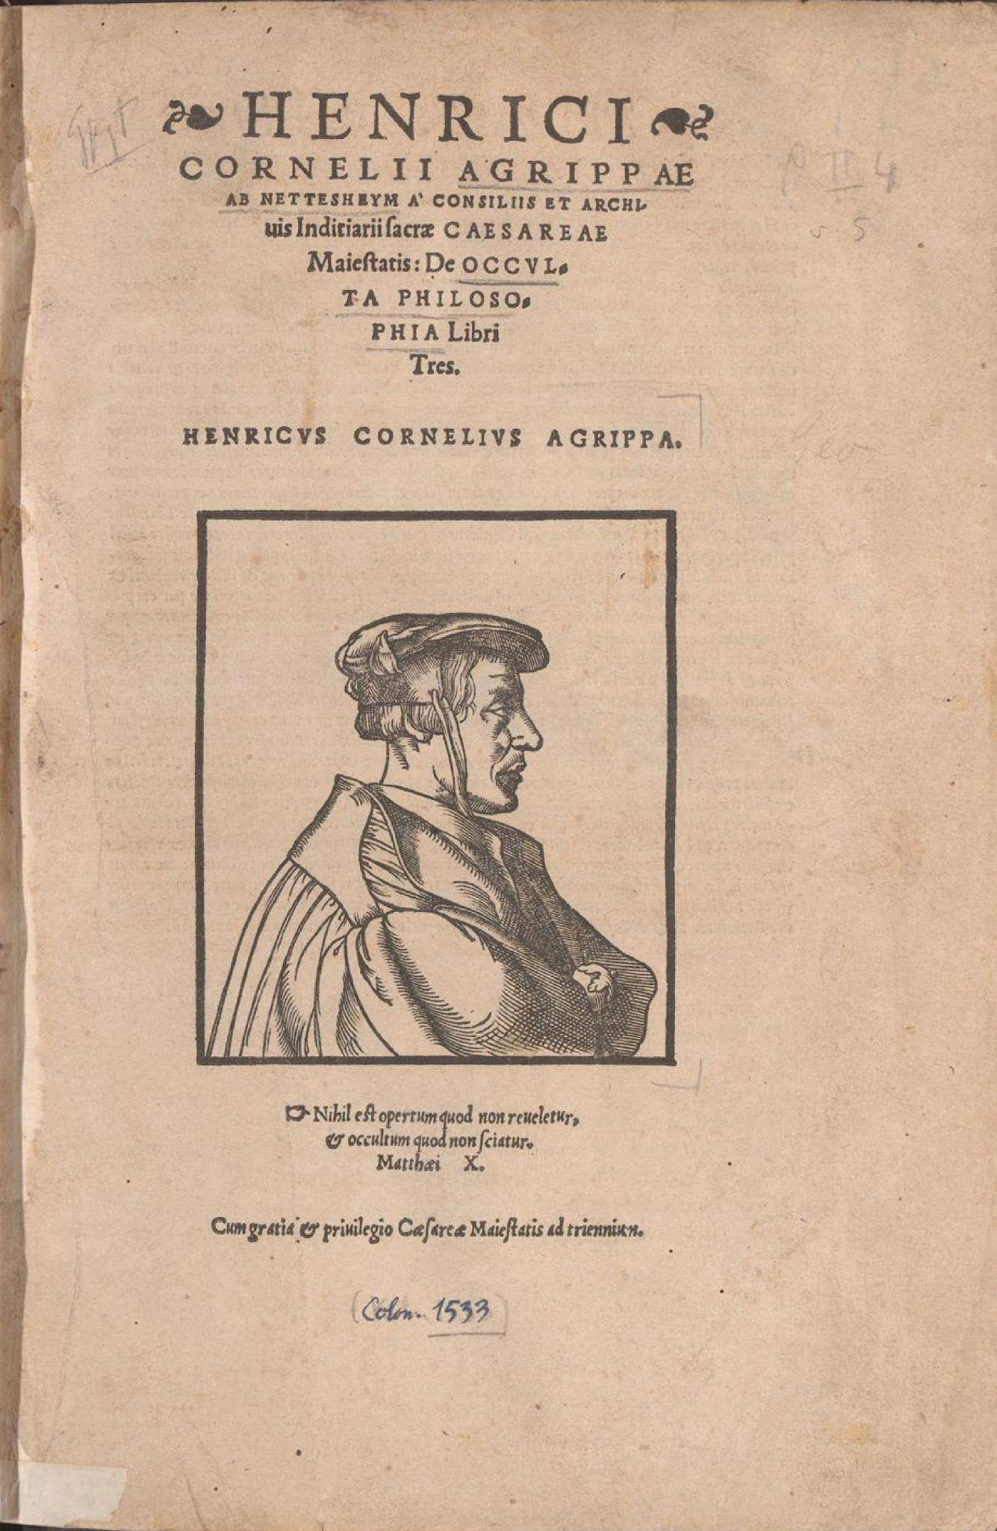
Introductions & Rationale
Why Agrippa?
More Celebrated than known
Hinge of modern occult philosophy
Hinge of modern occult practice
Importance as a philosopher

Slide 3
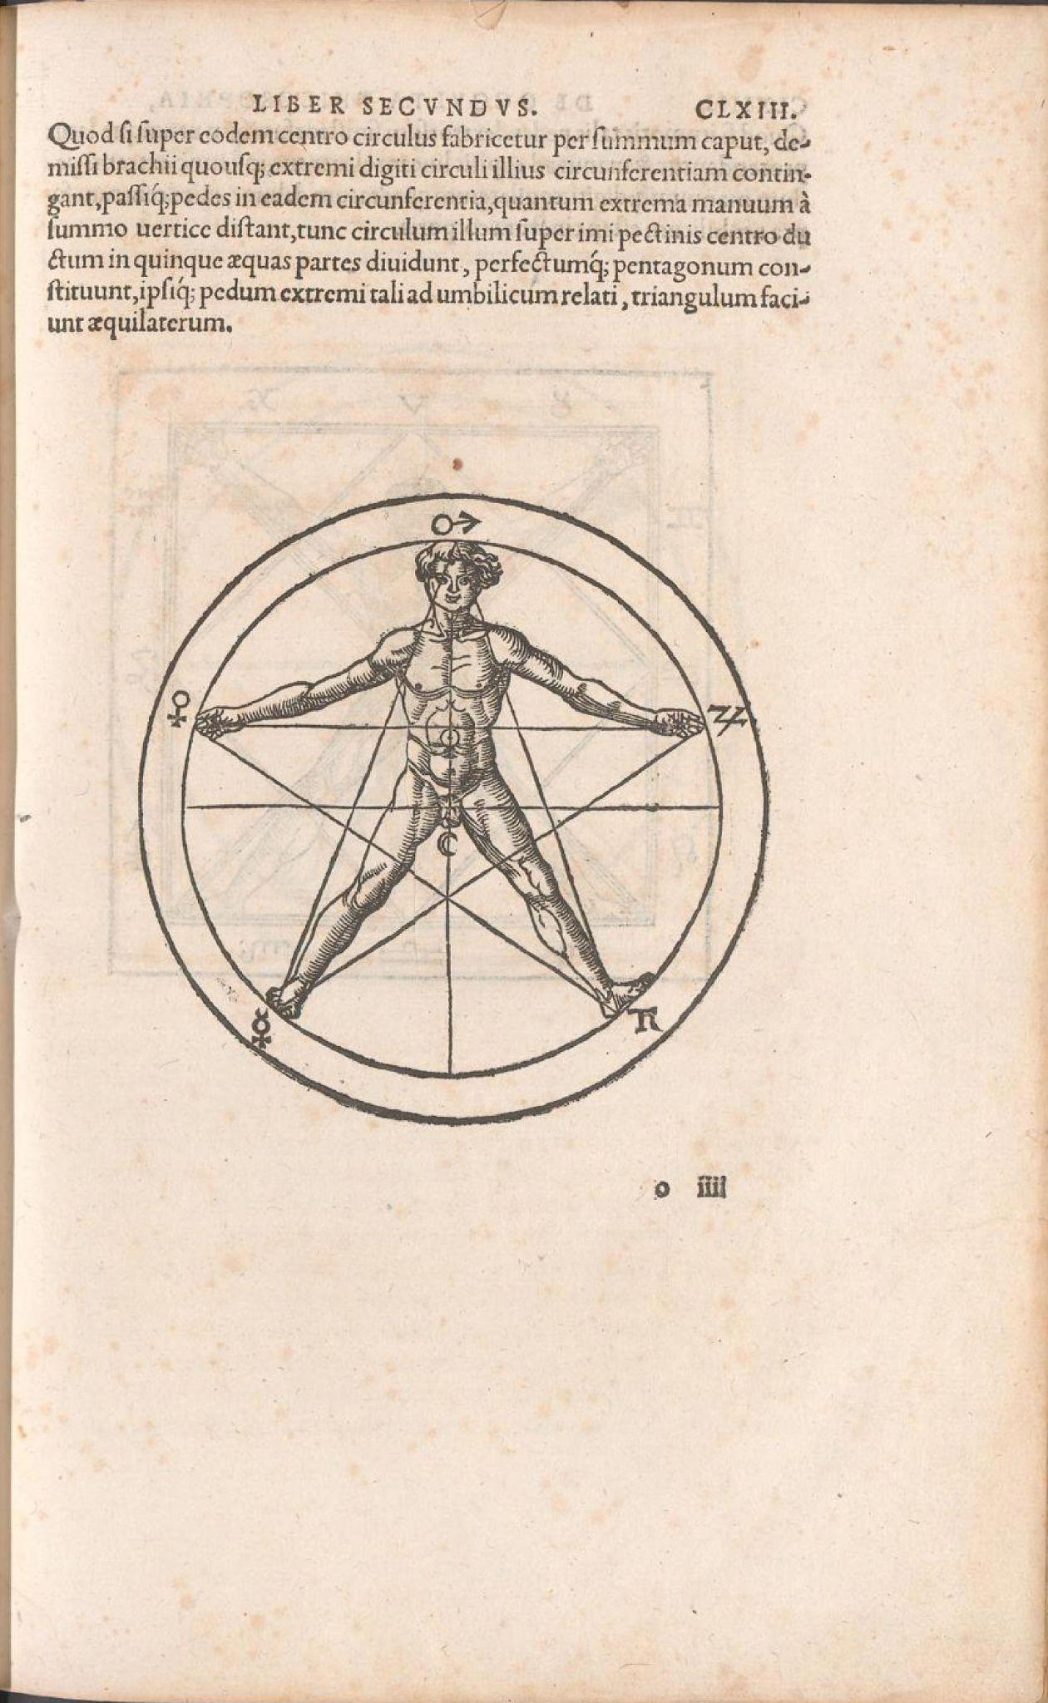
Introduction and Rationale
Provide an introduction to Agrippa’s philosophy
Situate him in the history of exoteric and esoteric currents
Demystify without dis-empowering
Not geared toward occult practice
But hopefully will empower any practice

Slide 4
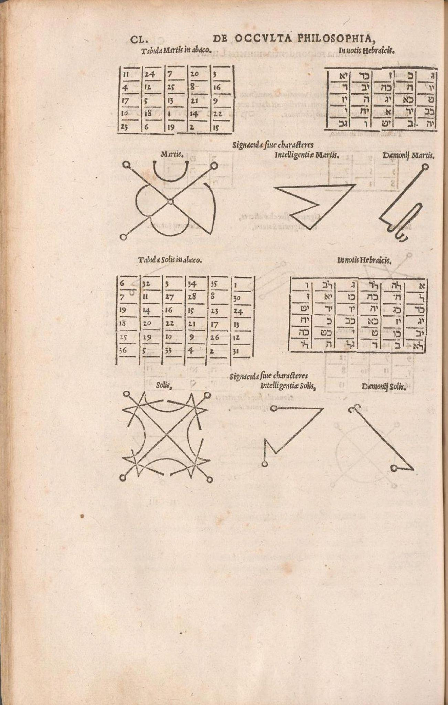
Course Path
Life and Outline of Major Works
Influences on Agrippa
Setting the Stage - the Juvenile Draft of the DOP
Development of Agrippa’s Thought
The DOP: The Natural, Celestial & The Divine World
The Skeptical Turn(?)
Impact
Final Analysis

Slide 5
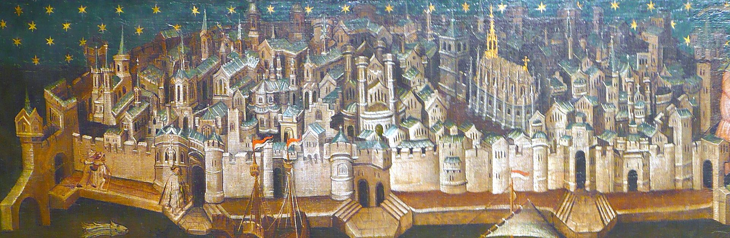
Life, Times & Works
Born September 14 1486 at Cologne into lower nobility
Learned astrology from his parents
Graduated University of Cologne July 22 1499, licensed March 14 1502
Said to have earned doctorates in both Law and Medicine at some point

Slide 6
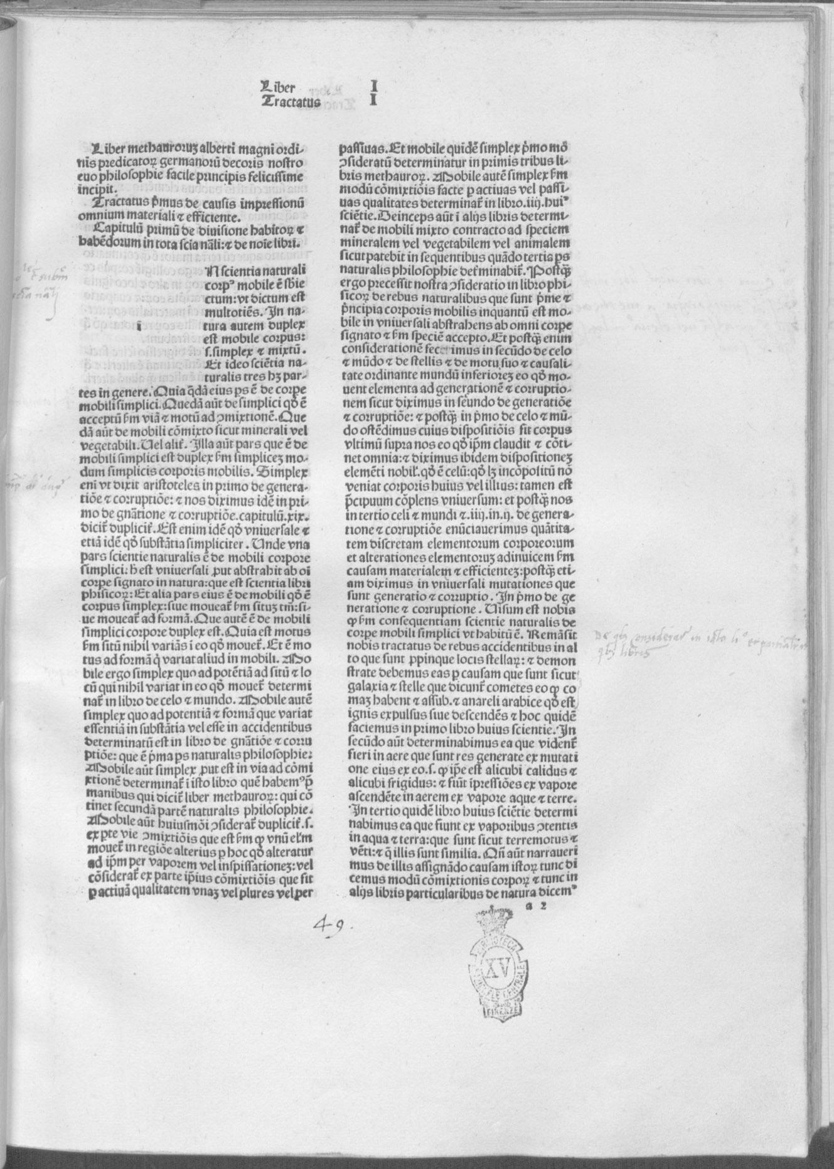
Life, Times & Works
Would claim that his teachers were slavish followers of Aristotle and Averroes
Cologne a center for Albertism, probably laying the foundation for Agrippa’s early interest in the occult
Andreas Cante, famed Lullian, also an teacher
By 1507 he had transferred his studies to Paris, where Scotus and Ockham studies flourished
Eventually returns to Cologne for unknown reasons

Slide 7
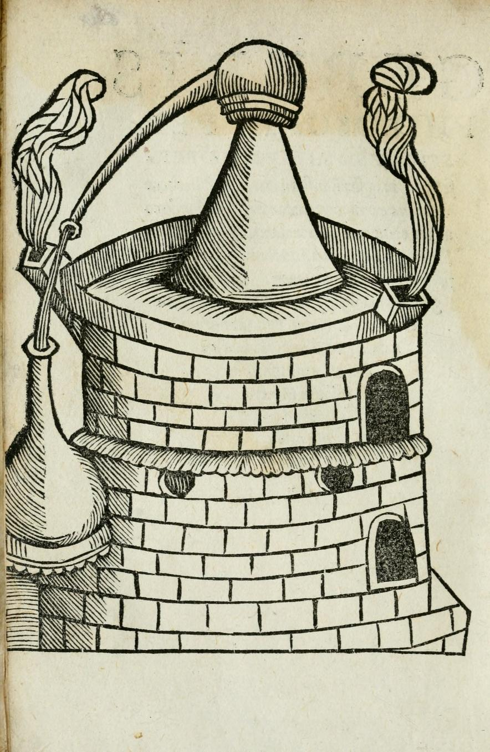
Life, Times & Works
April-December 1508 military expedition to Spain, seemingly to seize a fortified structure from rebel peasants near Barcelona
French Occult Secret Society exists by this time
Seems to have been a mutual aid society bound by common interests in the occult, especially Cabala, magic, hermetic philosophy, alchemy, etc.
The identities of the group are still mysterious
Members were required to be debt-free, Christian in good standing, swear an oath and have an interest in “arcane matters”
The goal of the studies seems to have been the exaltation of the soul, also the eventual goal of the DOP
Agrippa is certainly practicing alchemy at this time, setting up “our usual alchemy shop” as he travels

Slide 8
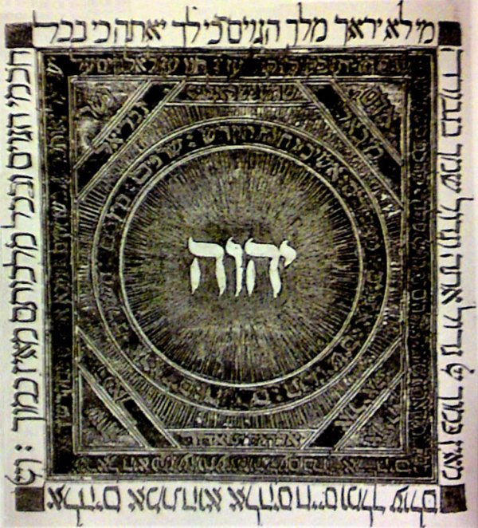
Life, Times & Works
1509 arrives at Dole and is invited to give lectures on Reuchlin’s De Verbo Mirifico
Central text of early Cabala arguing that a kind of theurgy centered on the restored Hebrew divine name YH(SH)VH could provide the magus with semi-divine powers
Briefly holds a chair of theology but needed the support of Margaret of Austria
Composes De Nobilitate in this effort, making nine arguments for the superiority of women over men, including arguments with Cabalistic, Hermetic and Neoplatonic elements
Publicly denounced in a sermon for “judaizing heresy” including teaching Cabala and promoting Taludic learning
Agrippa responds in a public statement, arguing that he is a good catholic but does not despise the rabbis either
By 1510 Agrippa returns to Cologne

Slide 9
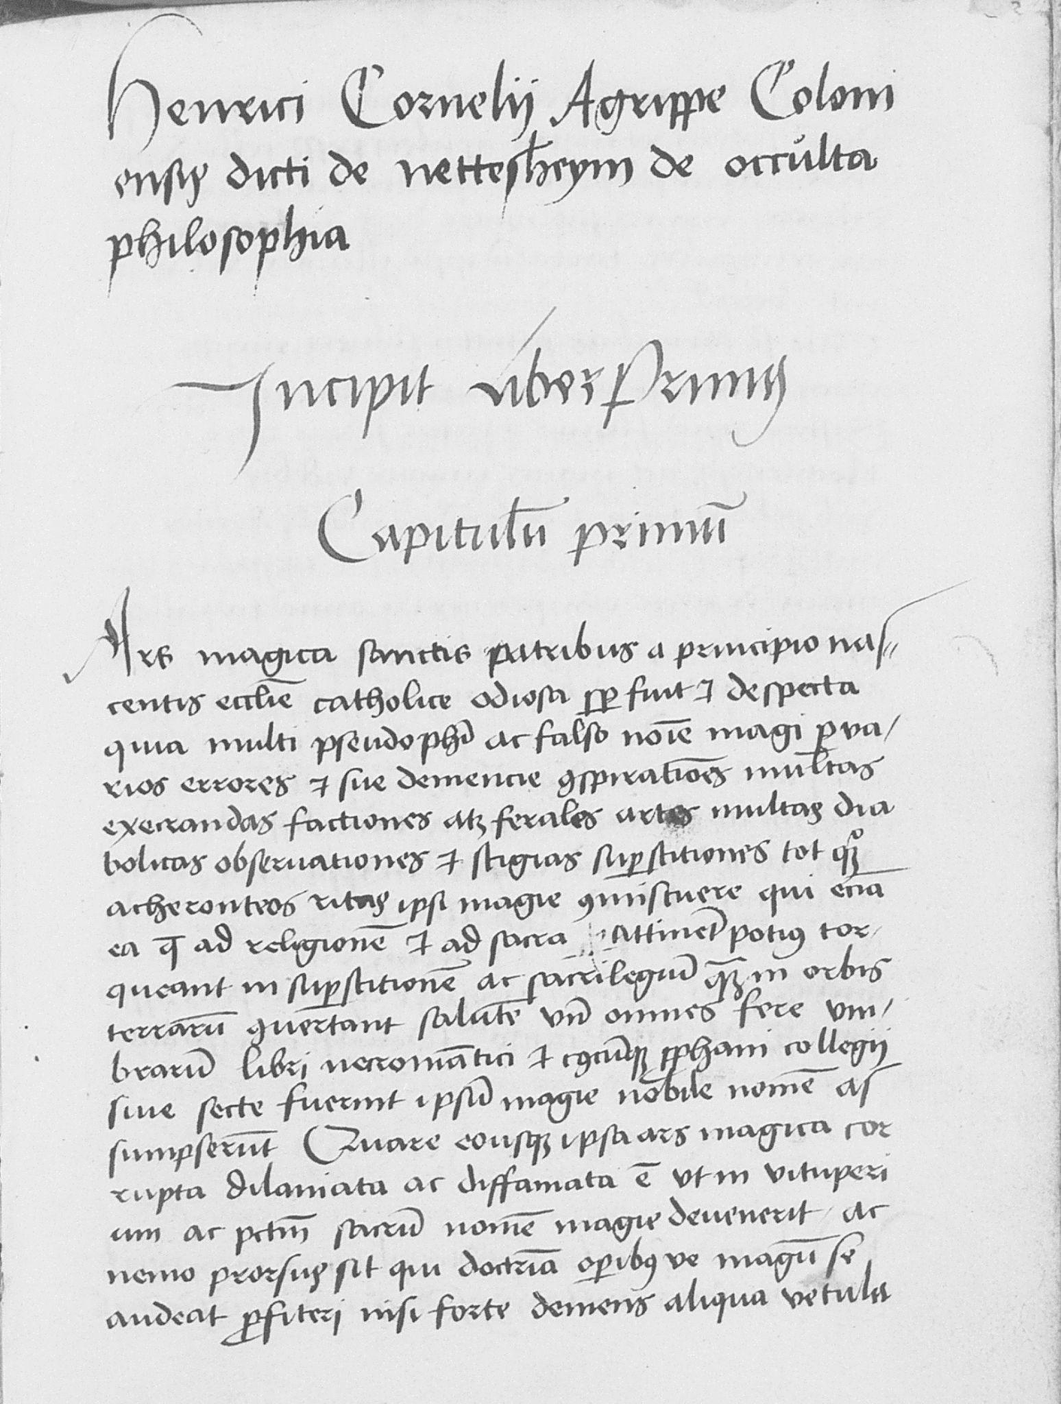
Life, Times & Works
Before April of 1510 he had composed the Juvenile Draft of the DOP, corresponding and meeting with Trithemius at Spondheim
Trithemius was probably the most learned occultists of this period, especially north of the Alps
His library contained the largest collection of occult texts in Europe
Trithemius lauds Agrippa and the DOP but urges him to be cautious in these matters
The MS of the JD of the DOP survives, perhaps in Agrippa’s own hand
Agrippa visits London in 1510 on “a most secret affair”
Studies St. Paul and composes a text on the subject
Engages in theological disputations at Cologne

Slide 10
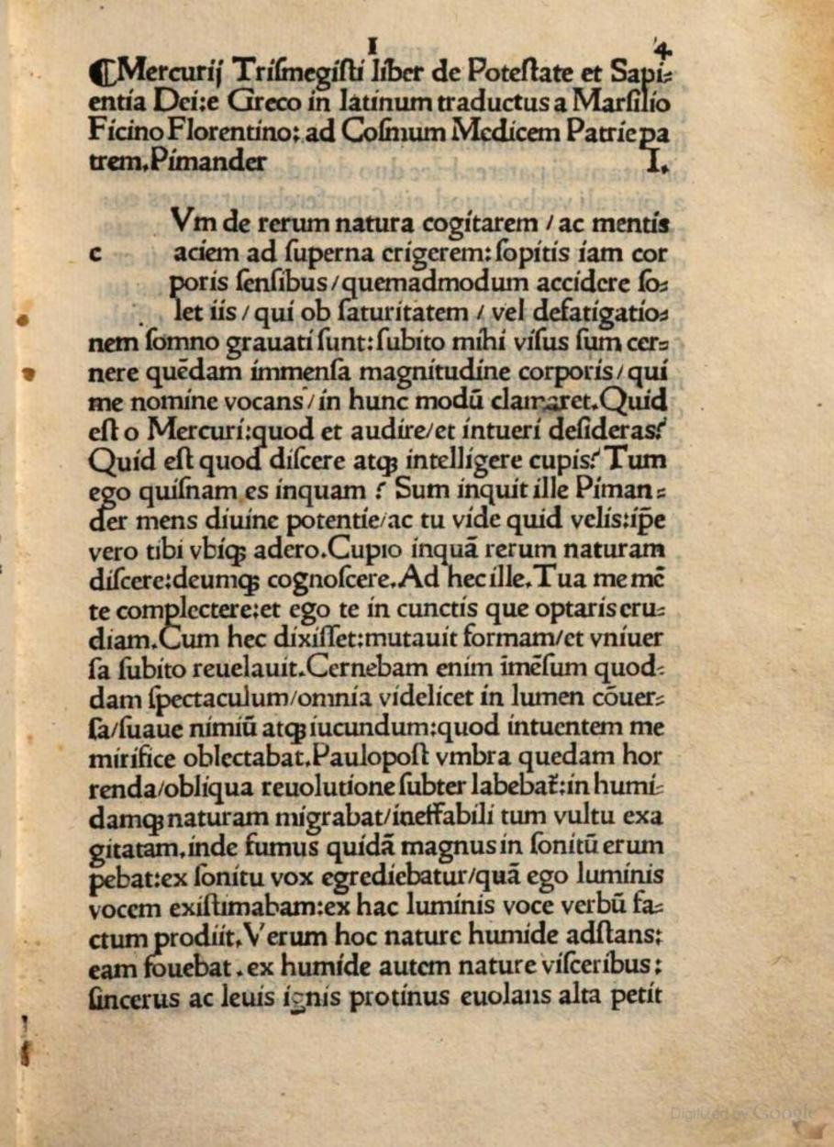
Life, Times & Works
Departs for Italy in 1511, a decisive period for his intellectual/spiritual development
Works in the diplomatic/military staff of Maximilian, for which he earns a knighthood
Extensive travels through Italy during this period
1515 lectures on the Hermetic Pimander at Pavia, fragments of which survive
Marries an Italian women the same year, has a son by 1517
Quickly makes contacts in the occult world, including Paulus Ricci
His chief studies seemed to have been Cabala and Italian Neo-Hermeticism
Seems to have been at the center of another occult study group
Composes his most important Neo-Platonic/Hermetic works during this period

Slide 11
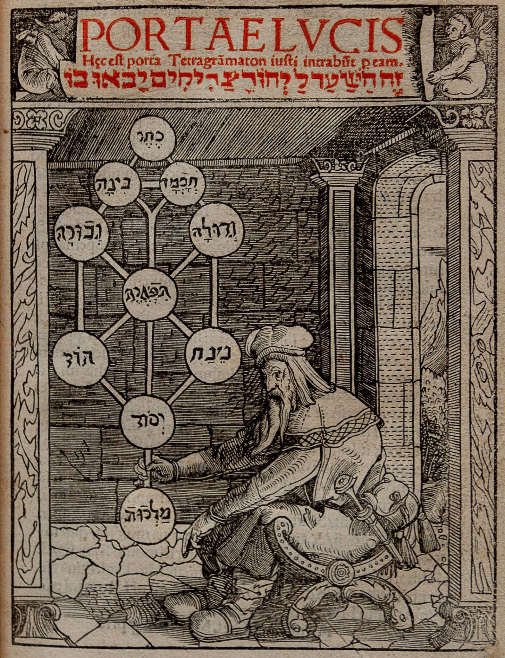
Life, Times & Works
All the works of this period share the central theme of how ancient hermetic and cabalistic wisdom are central to the spiritual restoration of human beings
This would also include the restoration of Adamic powers over nature, i.e., magic
However, because of Adam’s fall reason cannot lead to divine knowledge, only faith aided by esoteric wisdom
This argument would form the core of Agrippa’s skeptical bent and his ongoing assault on scholastic philosophy
Agrippa would deepen his studies of especially Cabala, including recent translations from Hebrew texts, especially Sha’are Orah / Portae Lucis
His reading of De Harmonia Mundi would also prove decisive
By 1517 political and military tides would turn and Agrippa would leave Italy for Leaves for Metz in 1518
He would later quip that he was “born in Germany, but educated in Italy.”

Slide 12
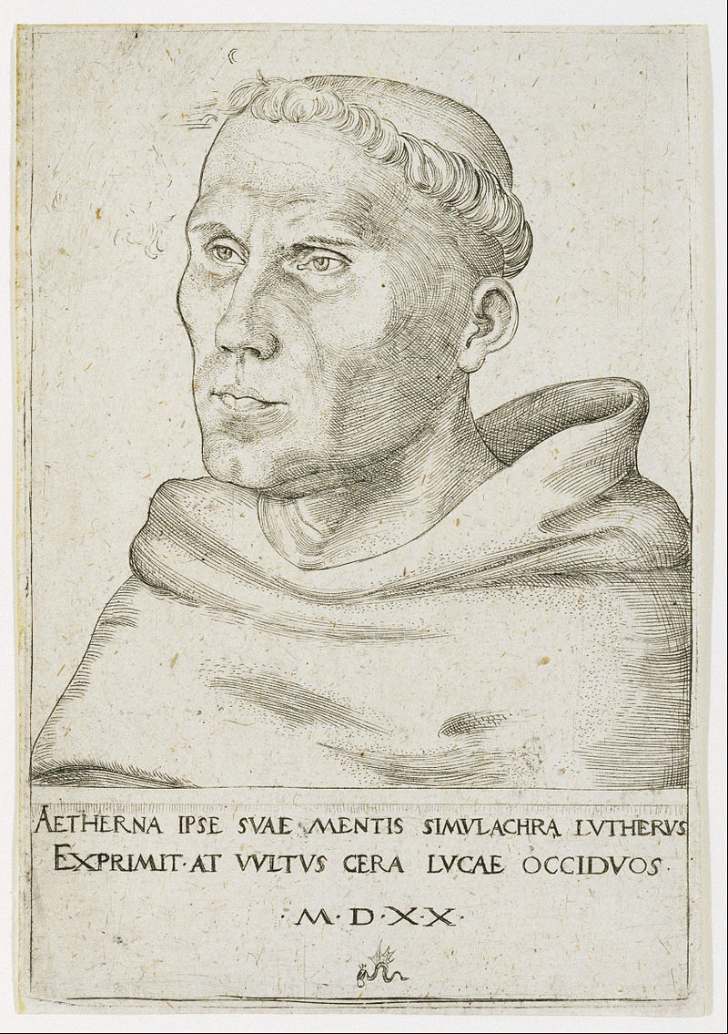
Life, Times & Works
He was invited to Metz to function as a legate
This would take him into the center of the growing reformation firestorm
Agrippa’s place in these debates is complex
He was pro-reform, anti-clergy to some degree, very centered on the importance of faith in salvation and had many friends that would eventually go over to the reformation
Yet, he seems to have regarded Luther as too radical, blaming the church for the ‘heretic’s’ success
Regardless, Agrippa lived and died a pious Catholic

Slide 13
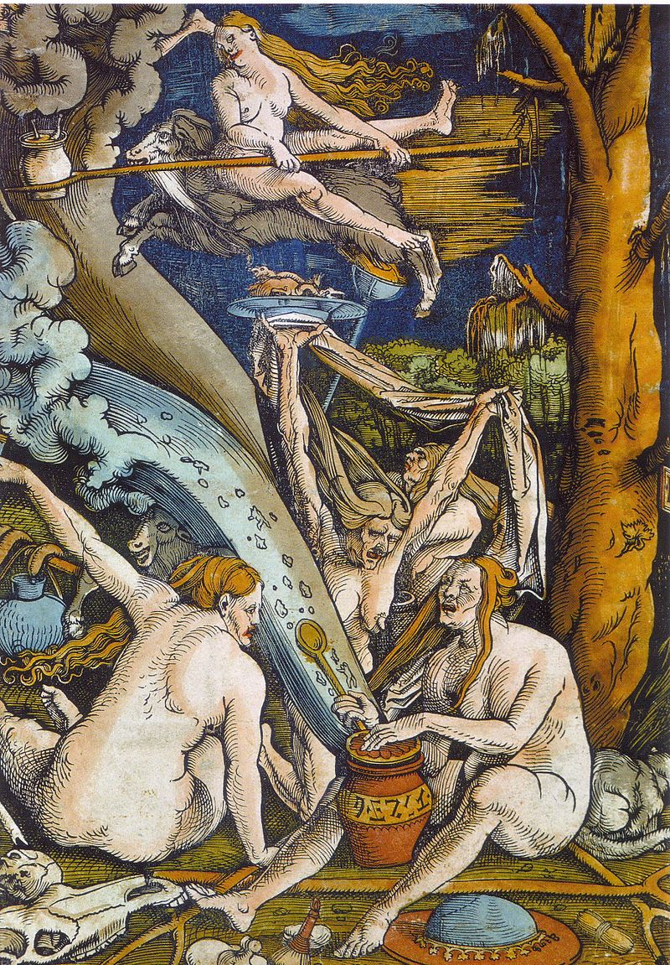
Life, Times & Works
Composes De Pecatto in 1519, where he argued that the original sin was sexual intercourse
He would also successfully defend a woman against witchcraft allegations on technical grounds
Agrippa maintained his belief in witchcraft (though he felt most were simply senile old women) but felt that this elderly woman’s rights had been violated by the local inquisitor
He even accused the witch hunters of heresy in that they argued that she was a witch because her mother had been one as well
Agrippa’s views on witchcraft would greatly impact his student Wier

Slide 14
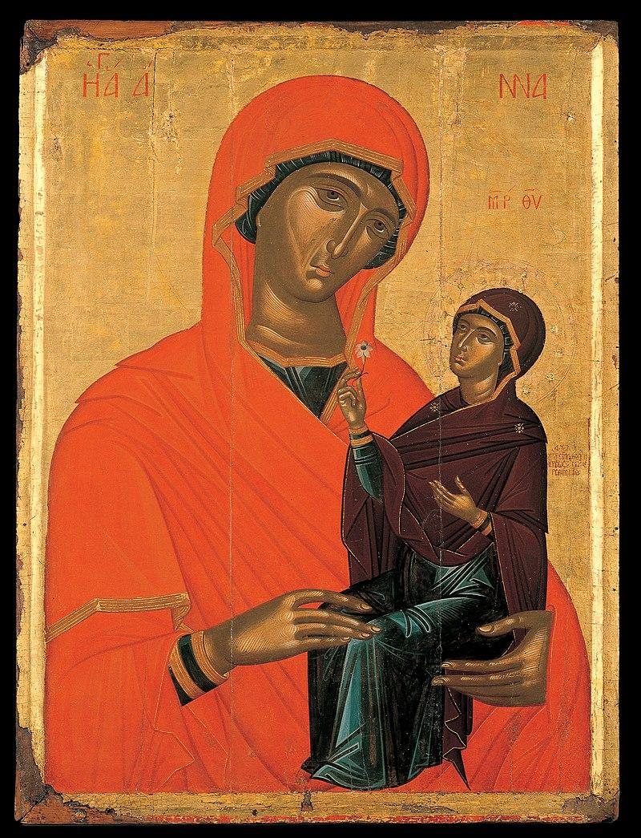
Life, Times & Works
He would also wade into the St. Anne controversy during this period, defending the position of Lefevre
He would exchange letters with Lefevre, who urged him to avoid too much controversy
Within the year he would tire of Metz and returned to Cologne in 1520
His first wife would die in 1521, he would marry again that year in Geneva who would bear him a daughter and 5 sons. Agrippa’s bloodline continued through the early 17th century, though it does not appear that his heirs inherited his interest in the occult
At Geneva he worked as a medical doctor
He would leave for France in 1524

Slide 15
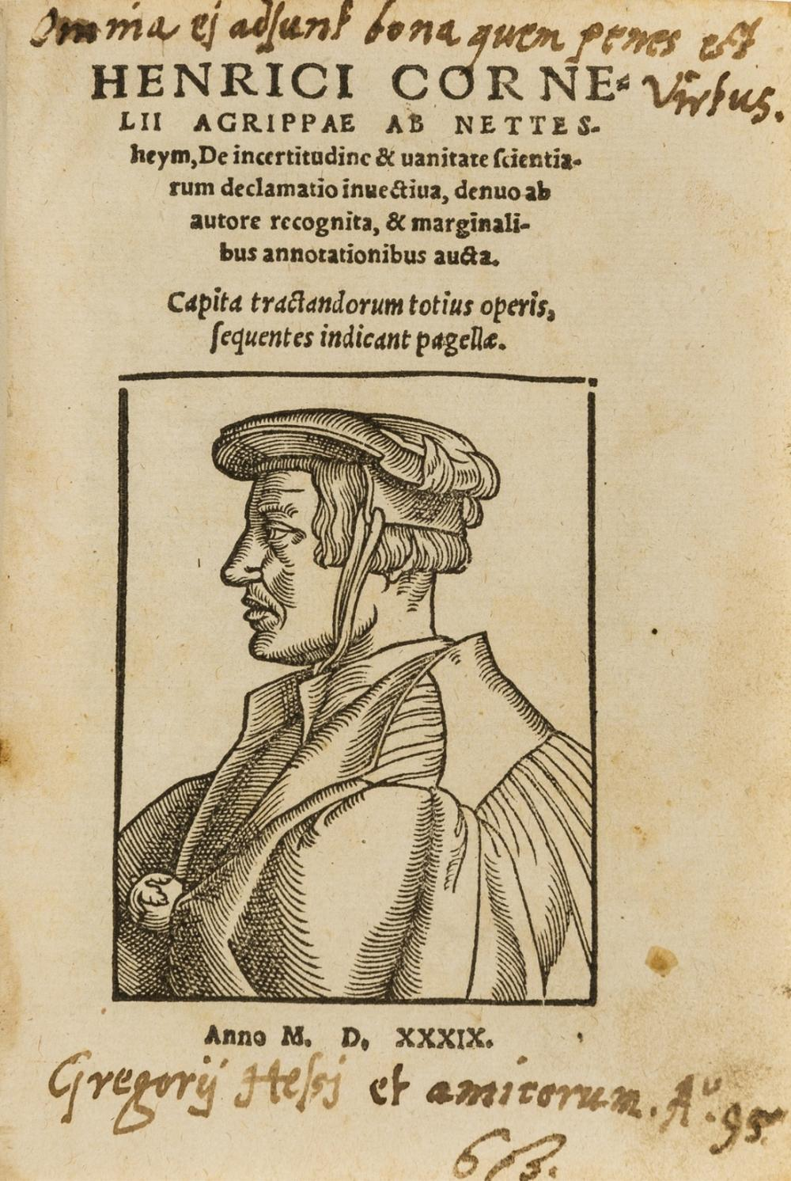
Life, Times & Works
His time in France was something of a disaster
He performed poorly at court, was caught criticizing the royal family behind their backs and engaged in further controversy
At Lyon he would compose his De Sacramento Matrimonii, which was criticized behind his back
He further courted problems in 1526 when he refused to draw up astrological predictions for the Queen Mother upon her son, criticizing her ‘astrological superstitions’ in a letter
Agrippa had a complicated relationship with astrology, accepting astral influence but rejecting fatalism. He would largely take over the position of Pico on the topic
He would eventually become de facto banished from the court
Dejected, he would compose the violently skeptical De Vanitate in the summer of 1526 all the while studying and practicing alchemy

Slide 16
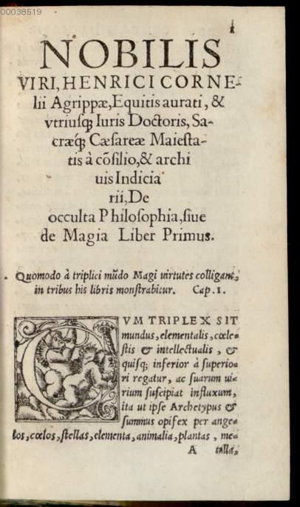
Life, Times & Works
He would eventually escape from France to Antwerp, a period of some prosperity, only for the plague to arrive which would likely killed his second wife in 1529
Here he worked as imperial historian and archivist
He would also gain permission to publish his works in 1529 which began to appear in print through 1531
Book I of the DOP would appear in 1531, in a now very rare edition
The publication of De Vanitate earned him the ire of the monks and academics who denounced it publicly in March of 1531
This also ruined his position at court
However, he would correspond with Erasmus at this tie, who urged him caution and to not court controversy

Slide 17
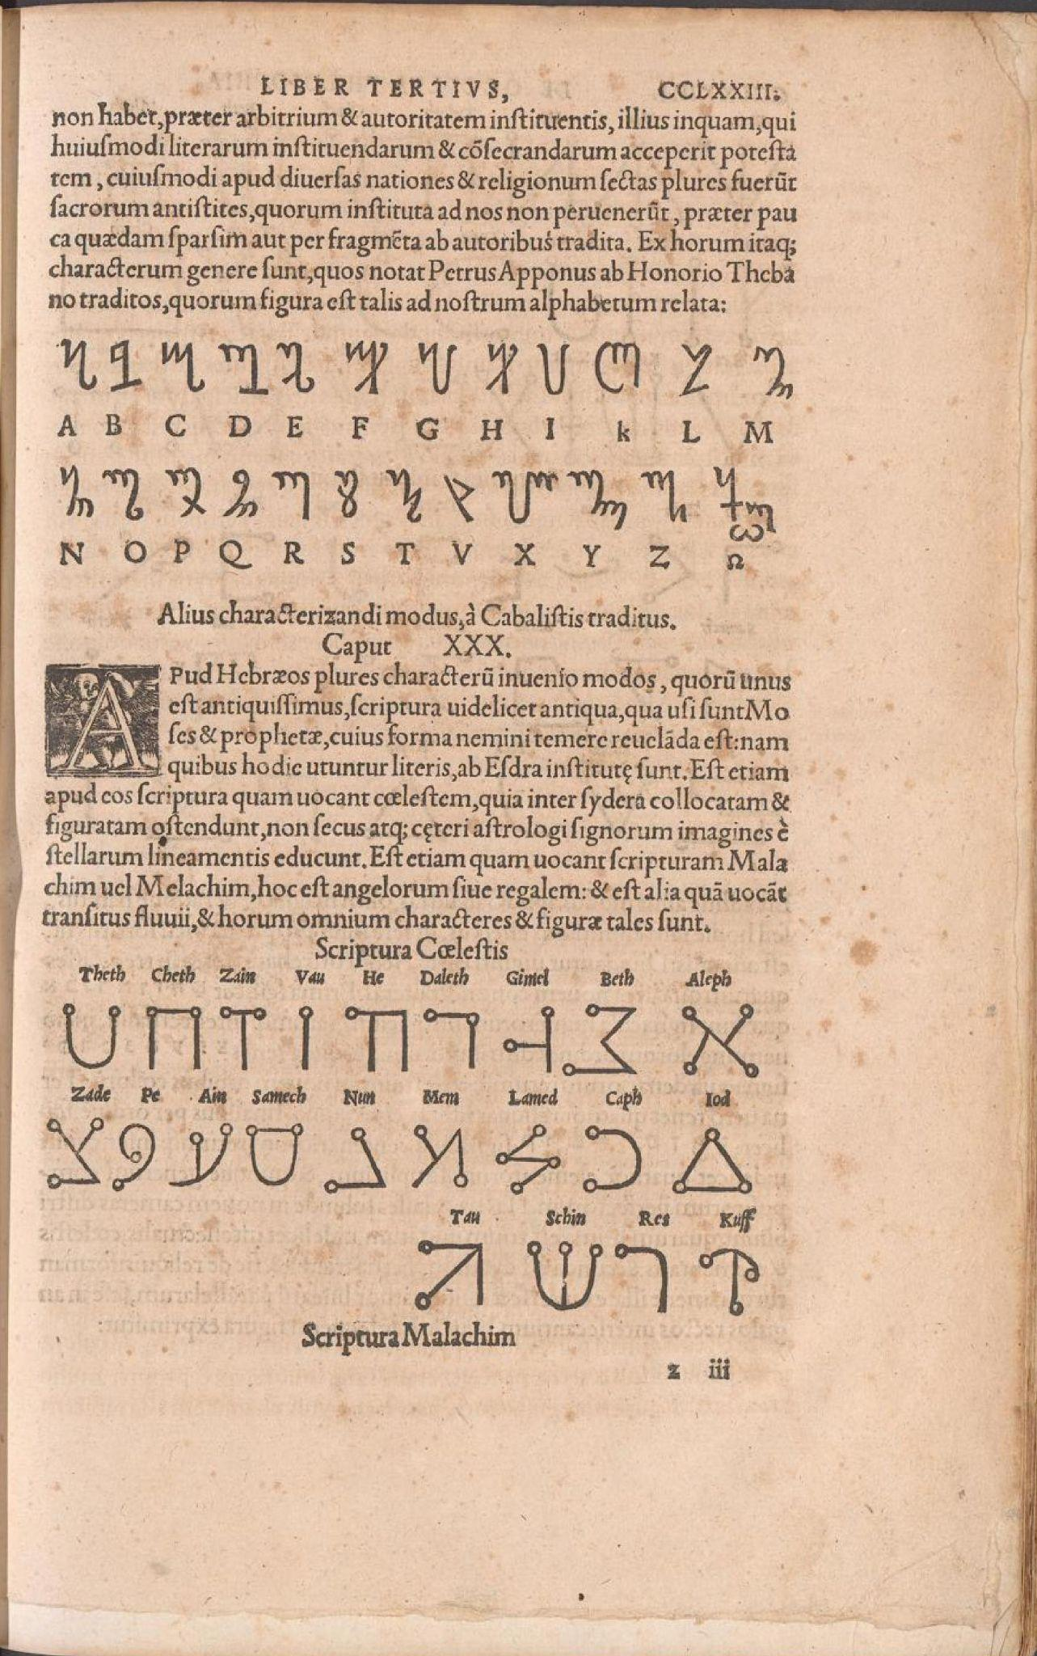
Life, Times & Works
He would also be invited back to Cologne by the reform-minded archbishop Hermann von Wied to whom he had dedicated the first book of the Antwerp edition of the DOP
By 1532 he was attempting to have the entire DOP published at Cologne but ran afoul of the Dominican inquisitors there
It would eventually appear in the Summer of 1533 in two slightly different editions
He would visit Italy once again on the merits of his alchemical knowledge
Then the trail goes cold
His student Johannes Wier reports that he returned to France, took another wife and then repudiated her in 1535, arrested at Lyon that same year before being released and dying at Grenoble that same year at the age of 49
He would ironically be buried at the Dominican church there - his grave is lost

Slide 18
How Agrippa Became Agrippa
Spinoza once noted that effects are the summation of their causes
To understand Agrippa’s occult philosophy we must understand his causes
Those causes are his historical but also his literary milieu
That milieu is bound up the recovery of ancient texts and their authority
With the conquest of printing and humanism
A general weakening of Church Power

Slide 19
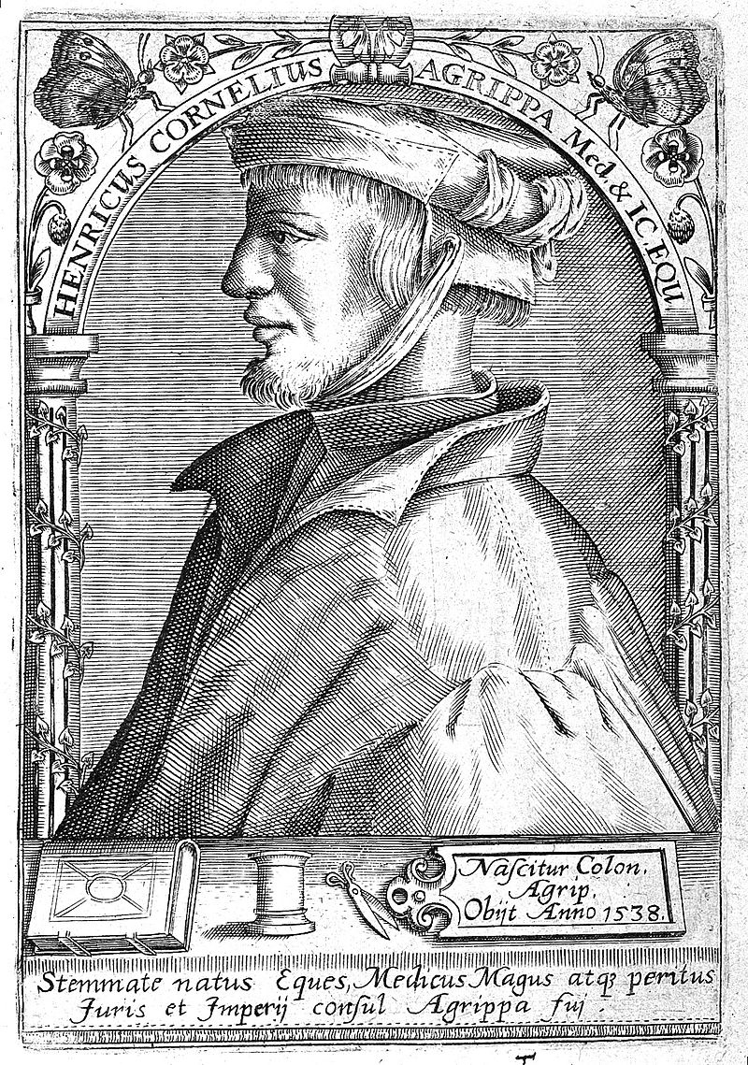
How Agrippa Became Agrippa
Agrippa probably read and/or spoke around 8 language: German, French, Italian, Spanish, English along with Latin, Greek and Hebrew
His literary sources are often surprising just as often as they are expected
The juvenile draft vs the 1533 is an important test environment
Let’s artificially divide them into exoteric and esoteric sources

Slide 20
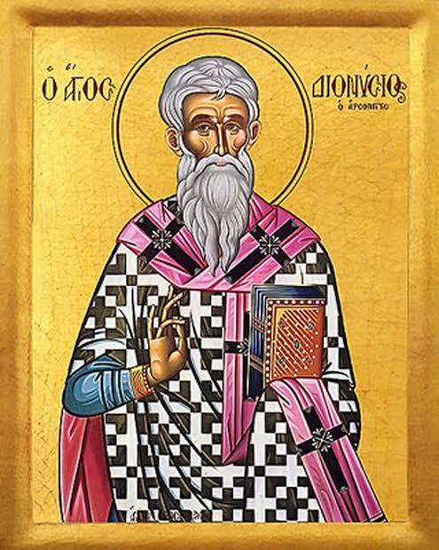
How Agrippa Became - Exoteric
Before being an occultists, Agrippa is a Christian and passionately so
Like his contemporaries, Agrippa thinks in and speaks Bible
But he is also grounded in Patristics, especially Eusebius and Hegesippus
This interest in the primitive church is bound up with his occult project
He also quotes Ambrose and Jerome
Most of all he is taken with Augustine and Pseudo-Dionysius

Slide 21
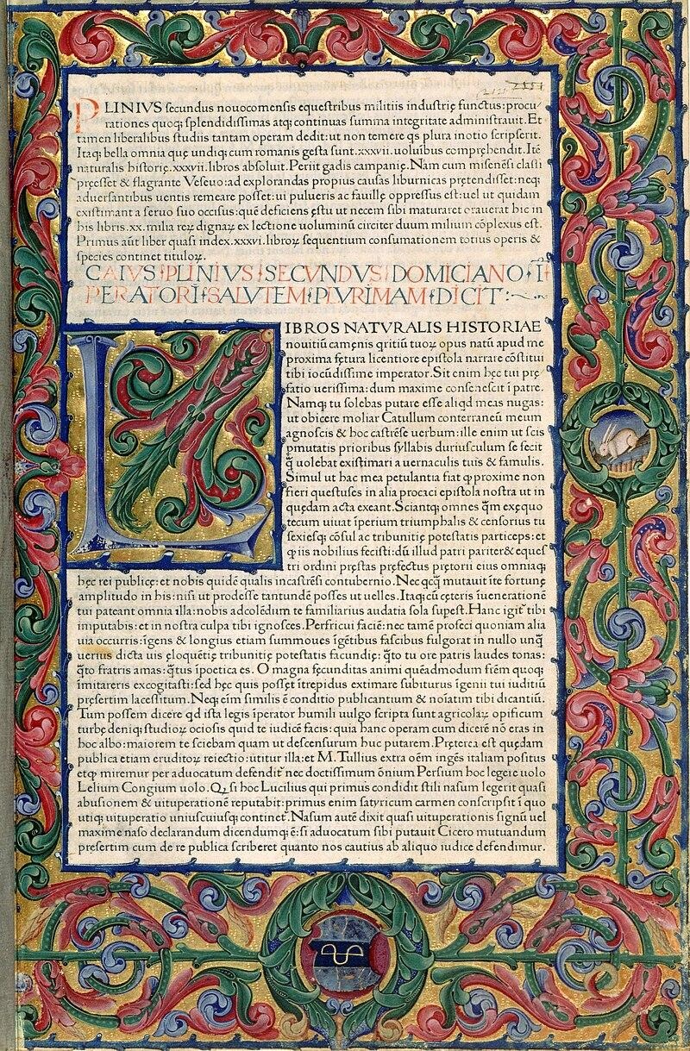
How Agrippa Became - Exoteric
Agrippa was, of course, a Renaissance Man and ardently pro Ad Fontes
Pliny’s Natural history is a constant guide, sometimes slavishly so
Agrippa uses classical sources like a mine
Vergil, Homer, Lucretius, Ovid, Lucan, Ptolemy and Boethius
He is also a repeater of the ancient tabloidist Diogenes Laërtius

Slide 22
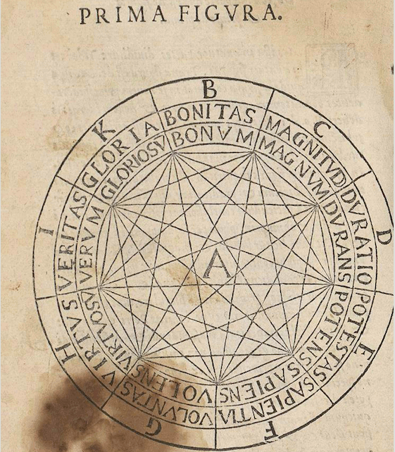
How Agrippa Became - Exoteric
Despite his disdain for scholasticism, Agrippa knows the literature
The Medieval Aristotle via Averroes and Lombard’s Sentences
Albertus Magnus, Thomas, Scotus and Ockham
He knows of Joachim of Fiore and his apocalypticism
His (mis)reading of Cusa would also be grist for the meal of his pious skepticism
Composes an entire extant commentary on Lull’s Ars Brevis

Slide 23
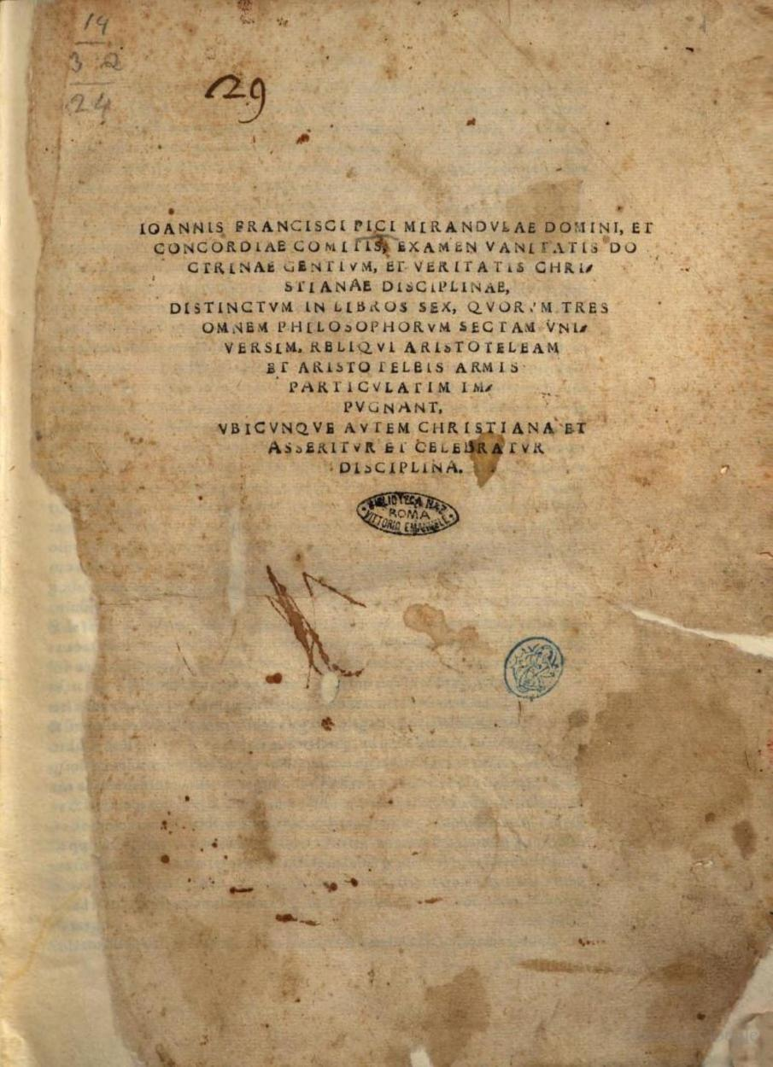
How Agrippa Became - Exoteric
Agrippa’s sources for his skeptical turn are difficult to pin down
There’s little evidence that he drew from Sextus Empiricus
Cicero’s Academica is also scarcely mentioned
Early humanism and proto-protestantism make their mark, e.g., via role of faith and grace
The 1507 De Vera Philosophica by Cardinal Adriano Castellesi
The 1520 Examen vanitatis doctrinae gentium, et veritatis Christianae disciplinae by Giovanni Francesco Pico della Mirandola

Slide 24
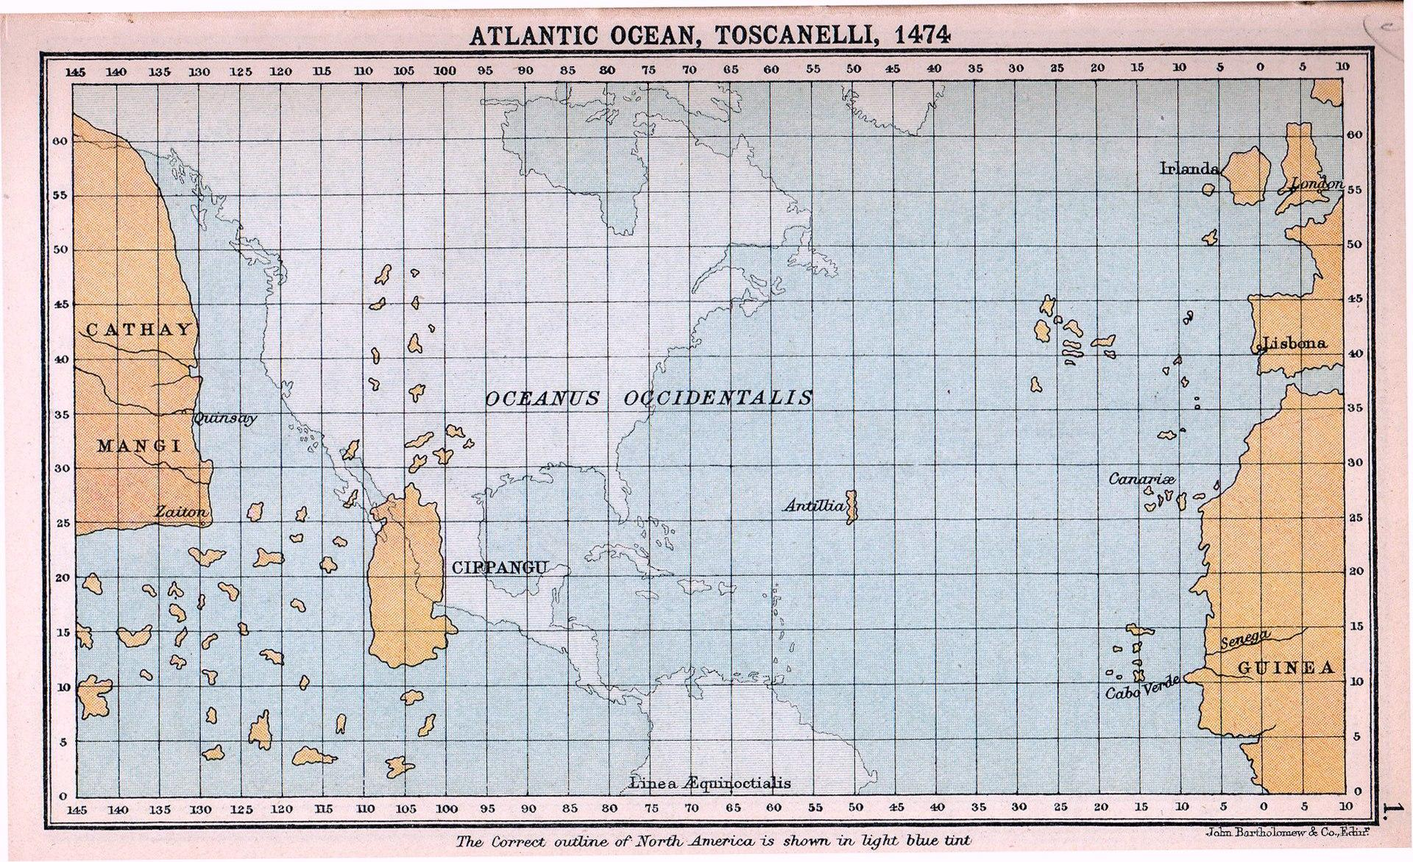
How Agrippa Became - Exoteric
The Humanist Agrippa was a reader of contemporary works as well
Dante, Petrarch, Boccaccio among others are mentioned
He quotes Machiavelli once and knows Paolo dal Pozzo Toscanelli
Agrippa’s legal and medical knowledge seems conventional
He does not appear to know the works of his contemporary Paracelsus
Acquainted to some degree with the writings of proto-protestants, especially Luther

Slide 25
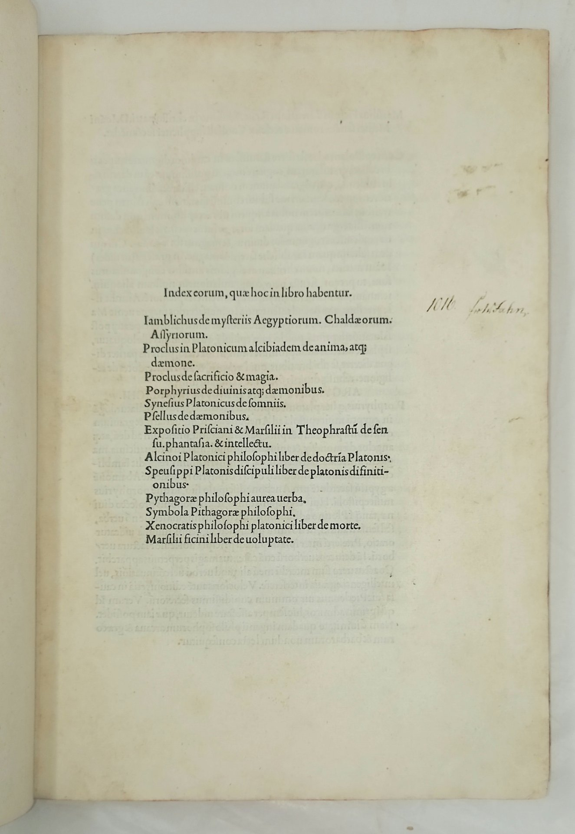
How Agrippa Became - Esoteric
Agrippa especially cites the Timaeus and Phaedrus along with other Platonic dialogues
He knows Philo, Plotinus (1492), Porphyry, Iamblichus and Proclus via the 1497 Ficino translations.
Seems to also have access to a MS of the Orphic Hymns, Ficino never published his translation
Knows and lectures on the Hermetica, prefers the Lazzarelli edition of 1505
Deeply influenced by Ficino and Pico
The Three Books on Life, 900 Theses and Heptaplus are ever-present

Slide 26
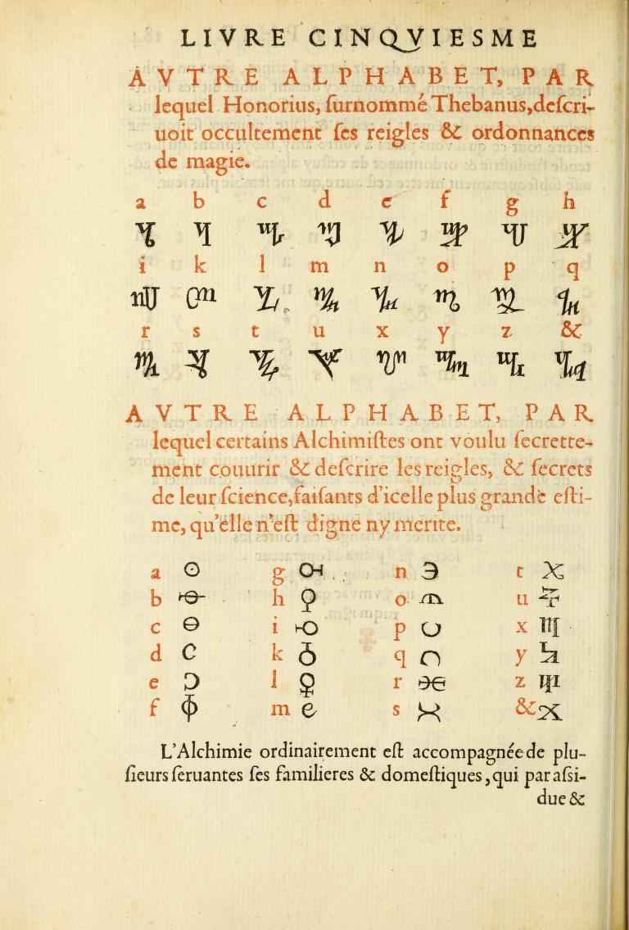
How Agrippa Became - Esoteric
Agrippa knows and despises much of grimoire magic, i.e., medieval necromancy
Picatrix is a central text but Abano, Magnus, Bacon, Almadel and Al-Kindi are named
Having visited Spondheim he would have had some access to Trithemius’ library for a brief time and knew his works, especially the Steganographia
Agrippa is a reaction against medieval magic in the direction of Hermetic Exhaltative, Ficinian Celestial and Kabbalistic infused magic
Despite, this his knowledge of previous magical texts seems extensive

Slide 27
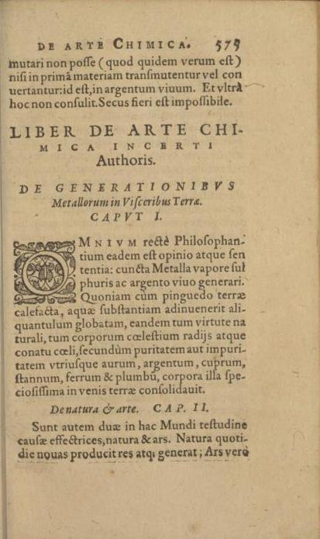
How Agrippa Became - Esoteric
Agrippa’s knowledge of astrology seems expert for the time
Deeply influenced by Pico’s attack on judicial astrology
His knowledge of alchemy also seems expert, though typical
If the De Arte Chimica is his, then there is a heavy infusion of both Ficino and Pico
In this way, Agrippa harmonizes his life-long alchemical practice with the philosophy of the DOP

Slide 28
How Agrippa Became - Esoteric
Agrippa’s first contact with Cabala is Pico and Reuchlin’s 1494 De Verbo Mirifico which he lectured on at Dole
Lifelong interest in Kabbalah but laments that his Hebrew is not strong enough to read texts (or the Bible) in the original
Seems to know Kabbalah second and third hand, e.g., Zohar quote from Crater Hermetis
Leans heavily on Reuchlin’s 1517 De Arte Cabalistica, Pietro Colonna Galatino’s 1518 De arcanis catholicae veritatis and Francesco Giorgi 1525 De harmonia mundi totius
Seems to know the Sefer Yetzirah but only after 1510, source unknown (first published 1552 by Postel)
Friends with Agostino Ricci whose brother Paolo translated Gikatilla’s Sha’are Orah as Portae Lucis in 1513/1516. Agostino also wrote a book about astronomy infused with Kabbalistic themes

Slide 29
The Occult Philosophy
The occult philosophy of Agrippa is no static matter
The only way to deeply appreciate it is diachronically
Luckily several esoteric and esoteric-adjacent works survive
Sadly most of these have no modern edition, much less translations
To construct a gestalt of the occult philosophy we will build as we go

Slide 30
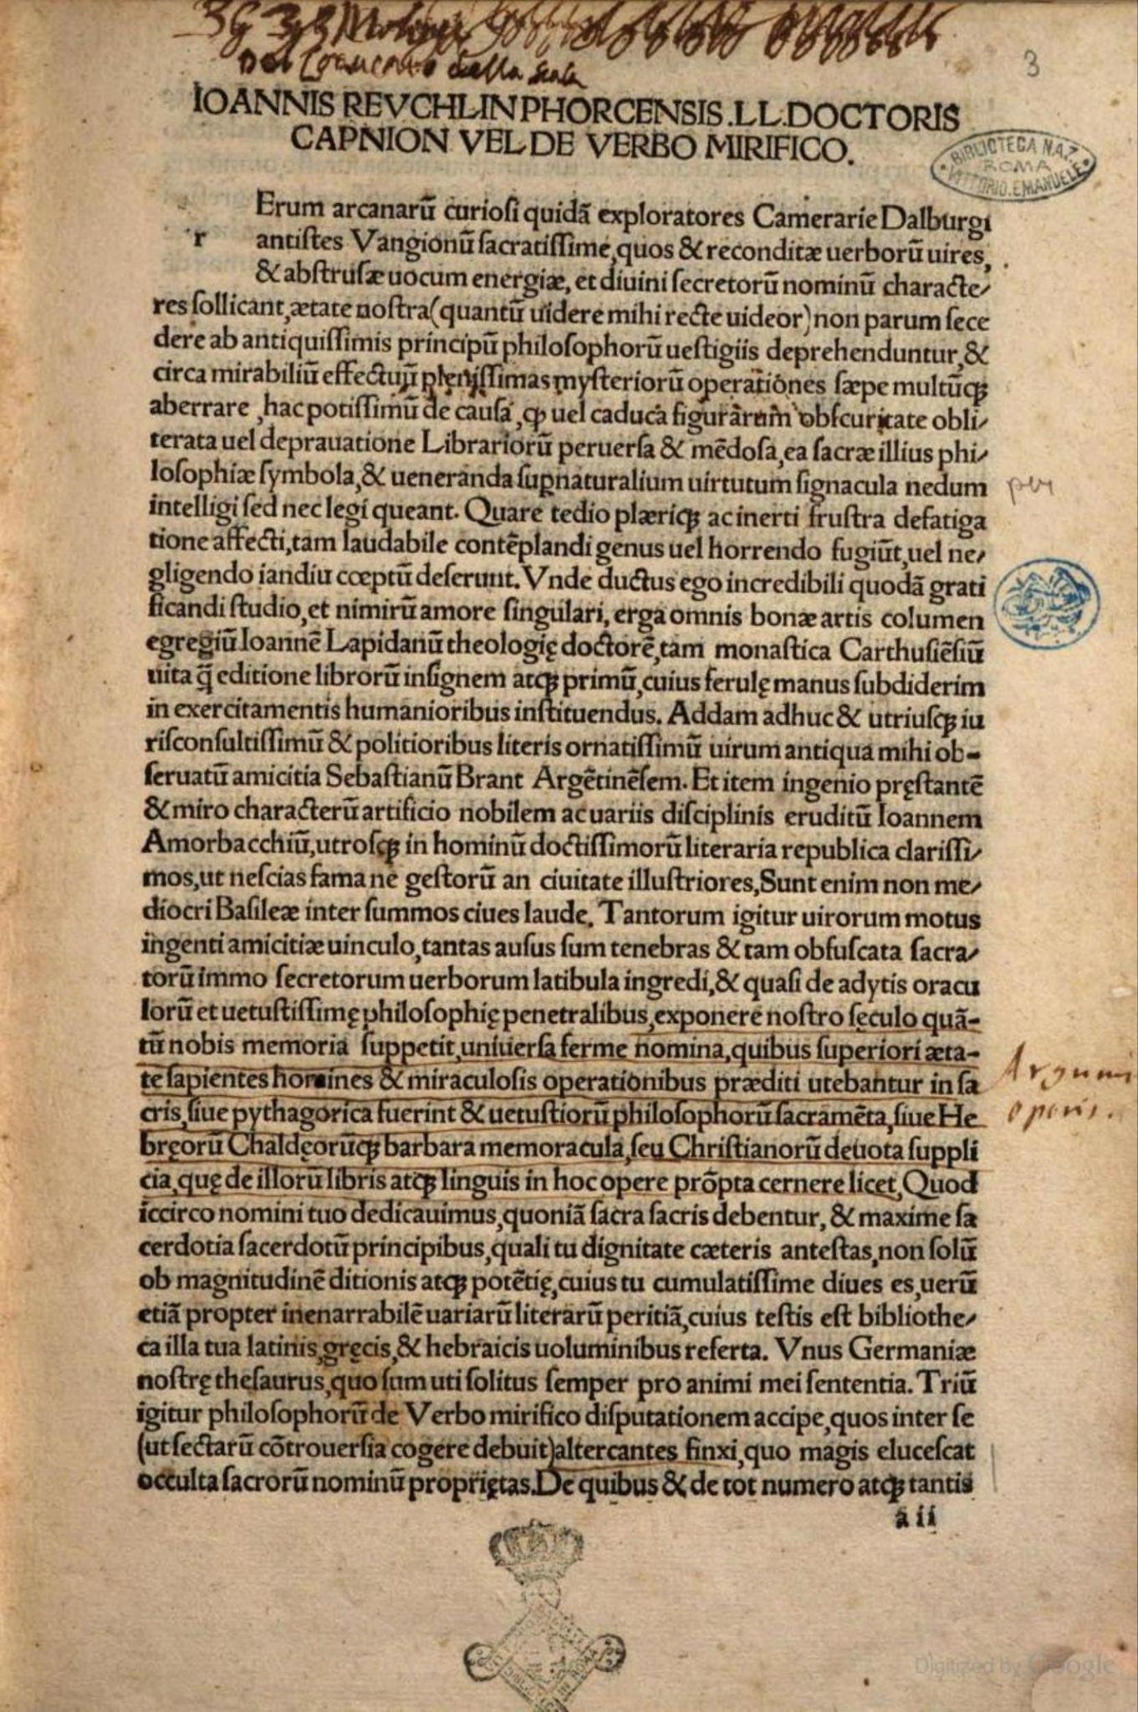
The Occult Philosophy
The Occult philosophy is a dialectical tension between the Grimoire tradition sublated into the Italian Magical Reformation
The Occult Circle is probably the crucible for Agrippa’s thinking
That circle was primarily concerned with mutual support
Studying the wealth of recently available esoteric and mystical works available
Most central seems to have been alchemy, hermeticism, magic and Cabala
Agrippa’s earliest public lectures were on Reuchilin’s De Verbo Mirifico
These lectures (not preserved) were attacked as “Judaizing”

Slide 31
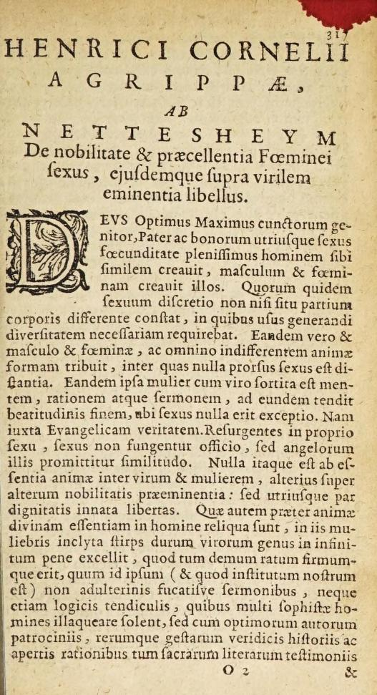
De Nobilitate et Praecellentia Foeminei Sexus
To secure an academic position Agrippa needed the vote of Margaret of Austria, Duchess of Savoy
For better and worse, she was very much preoccupied by diplomatic matters
In 1509 publishes Declamatio de Nobilitate et Praecellentia Foeminei Sexus to gain her favor
His arguments for the superiority, intellect and final blessedness of women are bound up with cabalistic reasoning
E.g., the first woman was associated with life (Havah) and the divine (YHVH) vs man with mere clay (adamah)
She was the ultimate, directly formed creature of God, with her genitals concealed but her face revealed

Slide 32
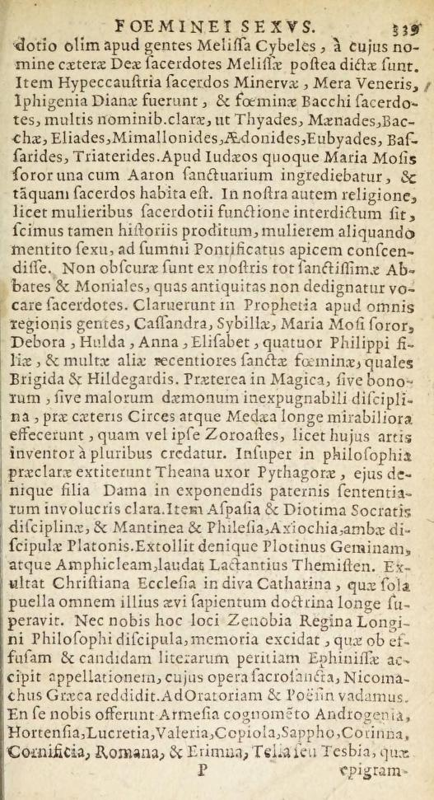
De Nobilitate et Praecellentia Foeminei Sexus
Women lend more to children than men and have, at least once, conceived without the aid of a man
Women are gifted with fine speech and are rarely born mute
Men, not women committed original sin, hence Christ had to be born a man and suffer as such
Women have the best of people - Mary - men have the worst - Judas
Women have become popes and fine warriors and only the tyranny of men and gatekeeping of education prevents the ascendance of women (c.f., Mary Wollstonecraft)

Slide 33
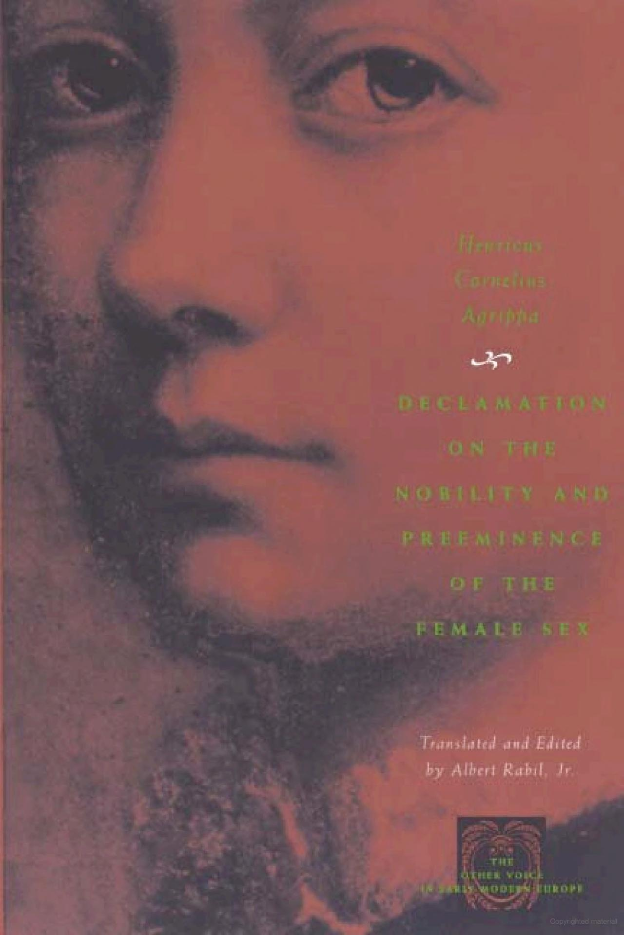
De Nobilitate et Praecellentia Foeminei Sexus
The attack by the Franciscans for his “Judaizing” meant that the de Nobilitate probably never even reached Margaret
It would only be presented to her some 20 years later but had little effect
First English edition 1996
Hints are the Cabalistic and Neo-Platonic already at the foundations of the occult philosophy
Also testimony to his maverick intellectual character
Appears that during this period he was probably already at work on the JD of the DOP

Slide 34
The Juvenile Draft
He would return to Germany in 1509/10 and spent some time at Sponheim with Trithemius
During this period he would finish and submit a copy of the JP to Trithemius
The JD-DOP or De Magia is a tour-de-force of Biblical, Hermetic, Cabalistic and Neo-Platonic sources and ideas marshaled in the interest of reconsoling and re-uniting the soul with the divine and the specific miraculous powers one acquired during that process
To understand the DOP we must understand the Italian Magical Reformation

Slide 35
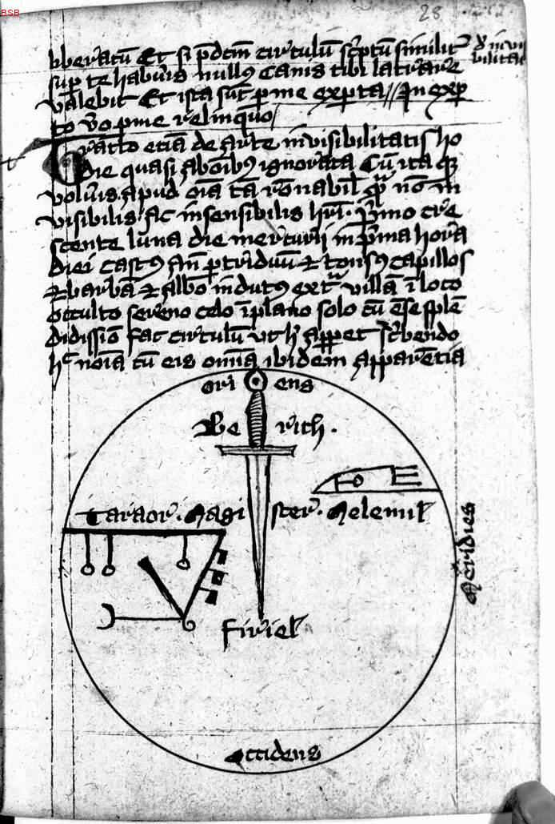
The Magical Reformation
The recovery of ancient pagan and Kabbalistic texts inaugurated a magical reformation pioneered by Ficino, Pico, Reuchlin, etc.
In general, this can be understood as a shift from Transactional Magic to Exaltative Magic
This generally tracks to a rejection of grimoire based magic (e.g., binding spirits) to transformational and theurgic magic
Informed by Ficino focus on Human Spiritus and Pico’s Dignitas
Break with Scholastic dialectic for Romantic Fideism
However, core foundations would remain unchanged: metaphysical sympathies, role of the occult sciences, etc.

Slide 36
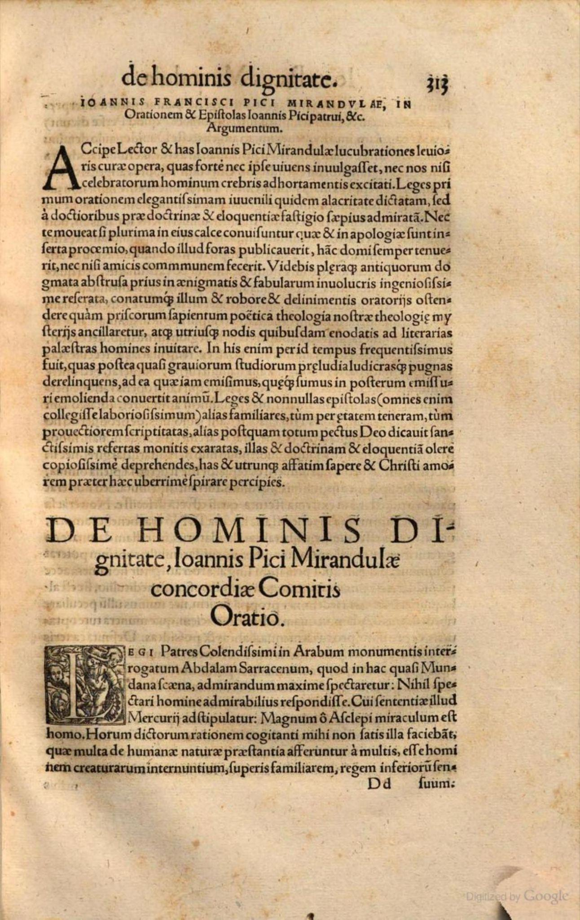
The Magical Reformation
What was rejected was the transactional magic of demon binding and magic as a means of control
Rather, emphasis shifted from man’s power to dominate Demons to Man’s Spiritus which allowed for Dignitas which freed him from outside forces, such as fortuna, as a magus
Dignitas: the ability to become God-like, achieve reconciliation with God and/or become unified with God “The knot of the cosmos”
This historically reserved for mystics who achieved such a state passively
Renaissance Magic would focus on achieving such a state actively and the miraculous powers that attended such a spiritual elevation
Neo-Platonism, Hermeticism and Kabbalah fueled this shift

Slide 37
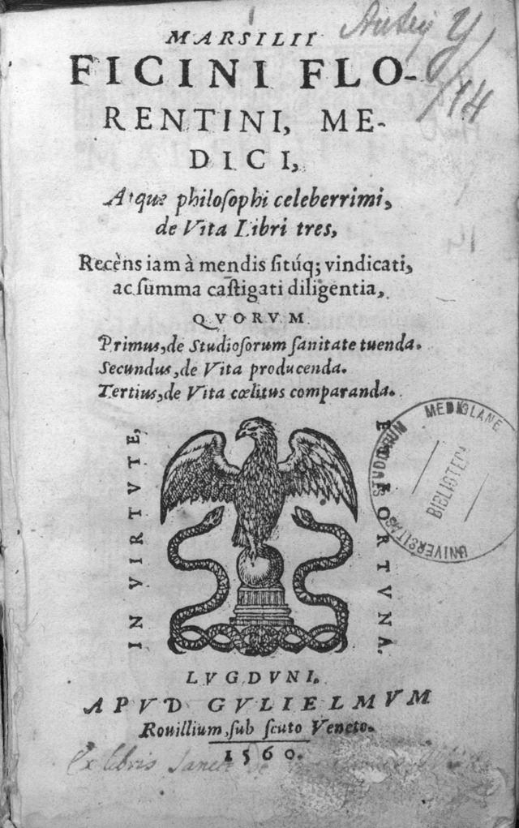
The Magical Reformation
Agrippa will largely be on board with this Magical Reformation
However, Agrippa will also bring to bear a more Pre-Reformation Element
At the center of the Reformation is a tension: the role played by daimones
Ficino and Pico actively attempt to limit the role played by Daimones opting for a more talismanic approach
However, Ficino allows for words and music to activate planetary radiation
Problem: Words and Music are only comprehended by Intelligent Beings, some of which are malefic, e.g., Saturn
Does this land Ficino back into quasi-demonic conjuration territory?

Slide 38
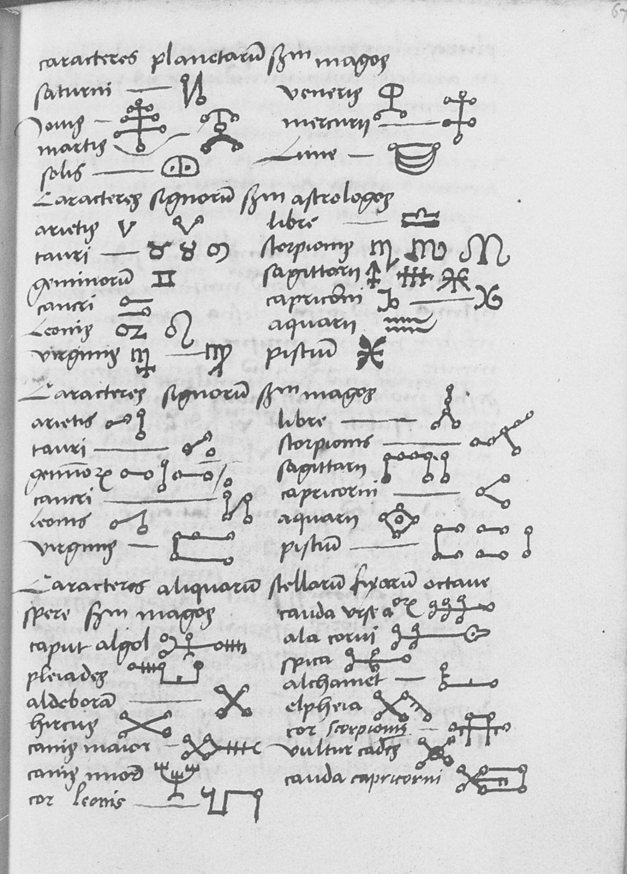
The Magical Reformation
Agrippa’s occult philosophy more attempts to weld elements of grimoire magic with the Magical Reformation
The DOP welds the (1) tradition of Albertism, with its focus on the occult sciences and “reading the book of nature
(2) The Magical Reformation focus on Dignification via Spiritus
(3) Cabalistic / Neo-Platonic cosmic theory and use of Divine Names
But also (4) the pre-reformation role of spiritual intelligences, including possible malefic entities
Thus Agrippa’s concept of Magic is much more transitive than that Ficino or Pico
The Reformation focuses on interior exaltation Agrippa shifts focus back to magic as transitive without it being (as) transactional

Slide 39
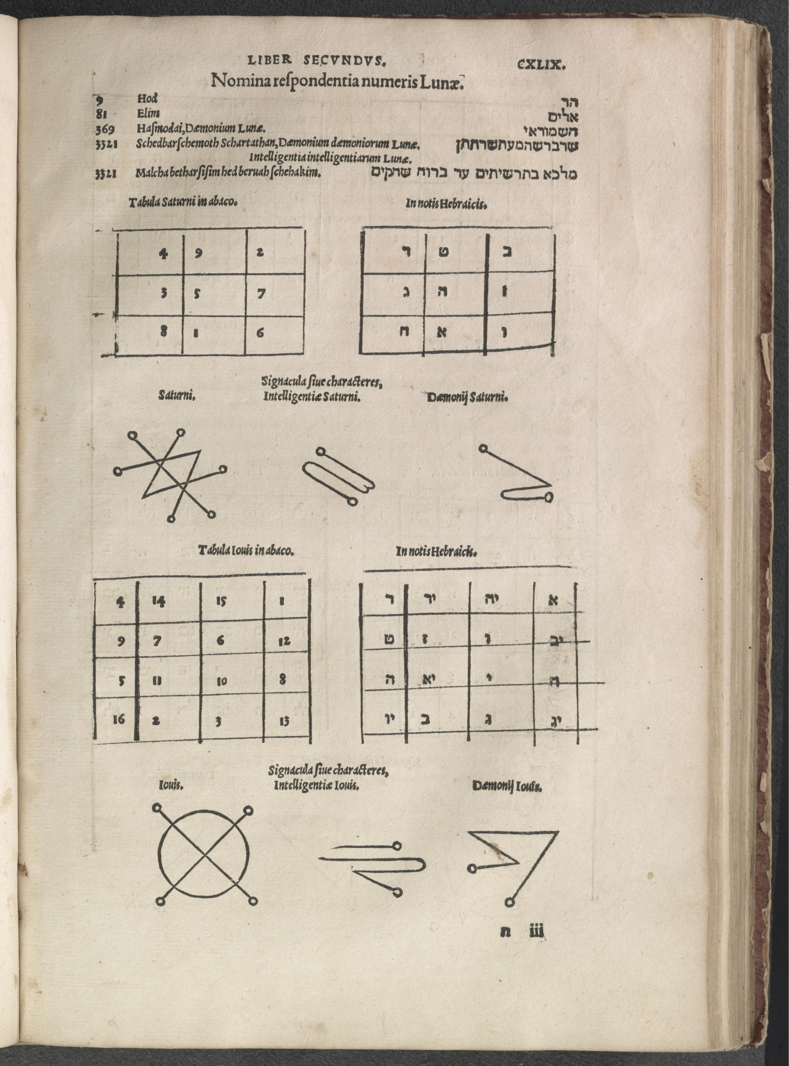
The Magical Reformation
This magical transitivity is ground on the occult sciences, celestial influence and theurgy
Agrippa’s Theurgy and commitment to the Prisca theologia puts him in a curious position
He radically accepts Extra Ecclesiam Nulla Salus but admits to the efficacy of even certain Jewish and even pagan “rites and ceremonies of religion”
This opens the door to a certain kind of Agrippan ritual Perennialism AND charges of providing dulia and latria to spirits for transactional magic
How does Agrippa avoid this? Elevated Dignitas via Spiritus hedges against malefic forces, admitting that the sacrifice of Christ is the truest and best and totally avoiding “perverse devotion and veneration” which Agrippa labels as “superstition”

Slide 40
The Occult Philosophy Appears
Did Agrippa peak in 1510?
While denoted as the Juvenile Draft the 1510 DOP is a complete work
What is the DOP? Summa VS Sententiae
A differential analysis with the 1533 reveals augmentation in quantity but not a change in substance
At the heart of the text is a mystical means to re-union with the divine and the attendant powers one acquires in that process
These are divided into Natural and Ceremonial magic, of which Natural magic contains both Natural and Celestial (mathematical) magic

Slide 41
The Occult Philosophy Appears
Why this won’t be a summary of the DOP
Summaries are excuses not to read
The purpose of this seminar is to empower your study
The DOP is resistant to summary
Summaries obfuscates fundamental issues
I just summarized it - the DOP is mystical means to re-union with the divine and the attendant powers one acquires in that process

Slide 42
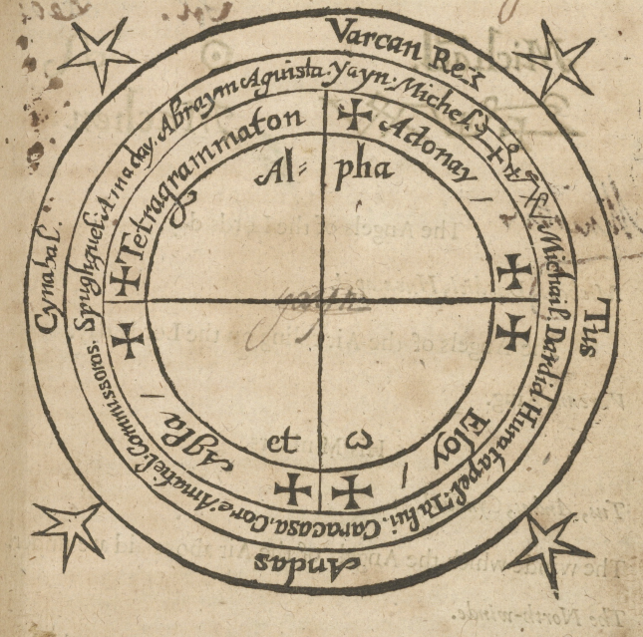
The Occult Philosophy Appears
Two problems lay at the origins of the DOP
The sad situation of magic
Doubts about the power of the human mind alone to grasp reality
The need to reform magic
The power of magic as a means to grasp reality
Magia as both means and goal

Slide 43
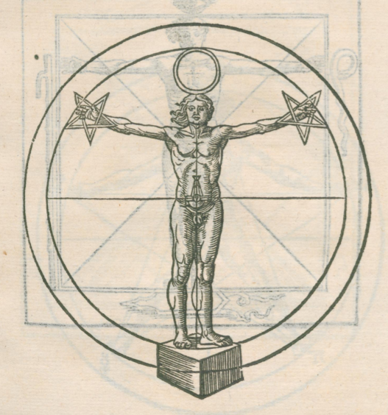
The Occult Philosophy Appears
The synthesis of medieval and reformed magic results in a paradox
The Illumination Paradox
Magic is a/the means of reconciliation with the Divine
Magic is only possible through divine illumination
Yet, magical practice must begin before such illumination
…and can be done contra the very aims of that illumination
I.e., summoning demons and necromancy
Problem: Equivocation on Magia as both Aim, Means and Boon

Slide 44
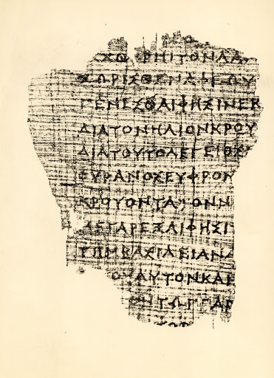
The Occult Philosophy Appears
Solution? Not to develop a new Magia but recover an old one
Restoration vs Innovation as hedge against the epistemological dilemma
Divine Revelation: Bible (+Esoteric dimensions = Cabala), Hermetica, Orphic Hymns, Platonism (+ Esoteric Dimension = Pythagoreanism)
Agrippa as Perennialist (in the best and worst sense, i.e., Christian Imperialism)

Slide 45
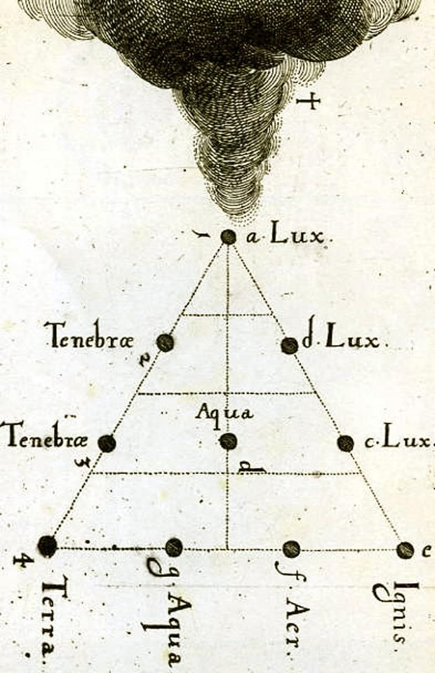
The Occult Philosophy Appears
At the center of this perennialism is Magia, the aim, means and boon of re-union with the Divine
Magia as the apex of philosophy, combining Physica, Mathematica and Theologia
Natural (Natural Magic + Celestial/Mathematical Magic ) + Ceremonial (dealing with Angels, Demons and Daimones + Divine Names)
Despite this, the DOP never provides a systematic treatment of the varying fields of Magic
The Vanitate destructively deals with such fields, and the Lecture on Geomancy are the closest such writings
The DOP assumes a fundamental unity of Magic

Slide 46
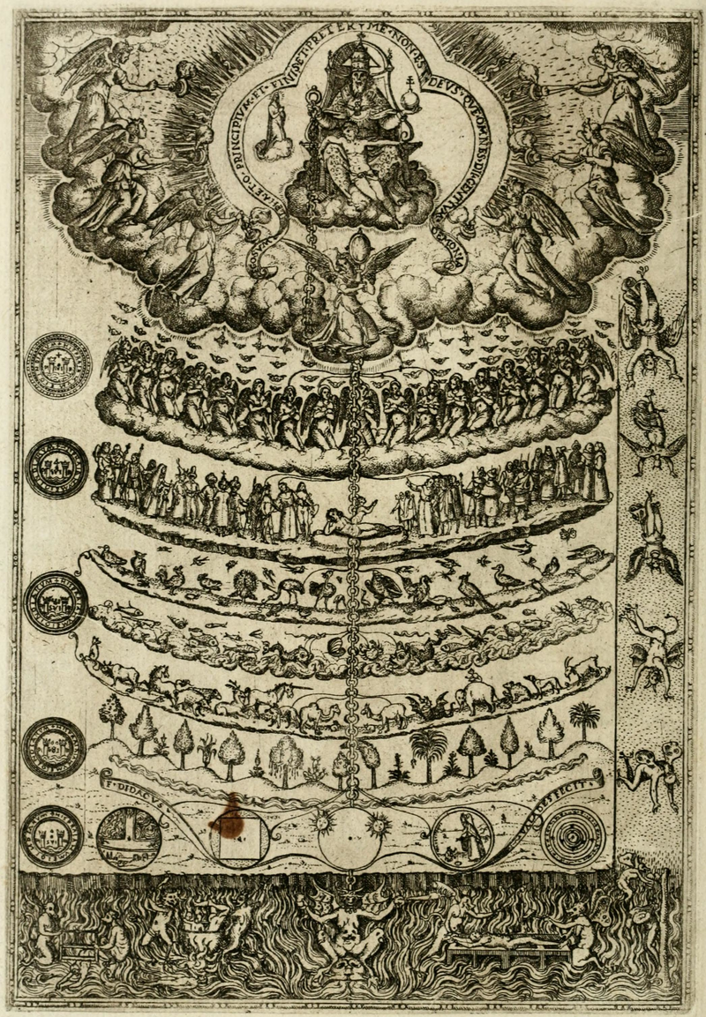
The Occult Philosophy Appears
At the core of his worldview is the Great Chain of Being
Platonic Conception of Reality - Emanation vs Creation
Three Realms: Terrestrial, Celestial and Divine
Despite his anti-scholasticism, he assumes Aristotelian Physics
Such physics extends from the Terrestrial to the Celestial Realm

Slide 47
The Occult Philosophy Appears
Such physics explains all exoteric causation
Agrippa, as an alchemist, admits of the Quintessence or Spiritus Mundi
This is the grounds of esoteric, i.e., occult causation
This occult causation has its origins in the Divine Mind but cascades down to Celestial Intelligences, Astral influence, Mathematical causation and natural occult causation such as magnetism and sympathetic causation
This structures reality and the human being: Elemental world (body) - Celestial world (spiritus) - Divine World (soul)

Slide 48
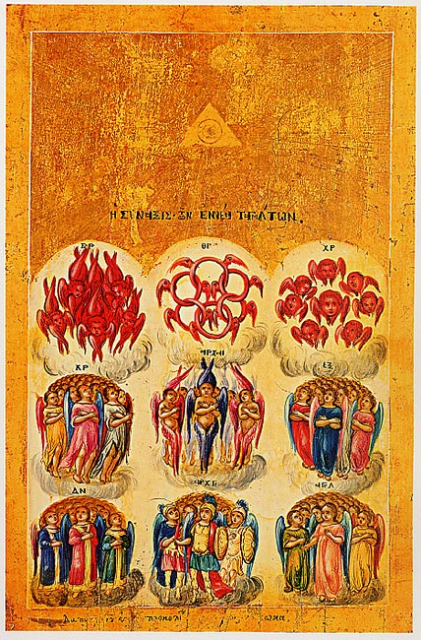
The Occult Philosophy Appears
Causation has a generally downward priority
The Astrological dilemma - Astral Causation as Fate vs Dignitas of the Human Soul
Sympathetic Relational Causation as grounds for Magic
Along with Human Beings the universe is populated by other Intelligences: Celestial, elemental, angelic, demons, etc.
Super-Celestial (no bodies but transmit the divine will), Celestial Intelligences, Daimones which preside over human beings directly
Human beings have three presiding entities: Divinely appointed, a nativity daimon and one bound to one’s profession
Daimones can be elemental, 9 species of angels, 9 species of demons

Slide 49
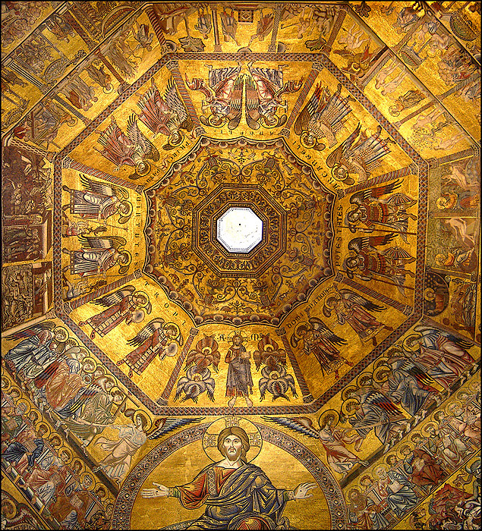
The Occult Philosophy Appears
The Daimones are empowered by their Names
These names are empowered through their origin in the Divine Name
Each Daimon has a specific function in the order of reality
Thus knowing their name and function allows the magus an instrumental relationship with them
Evil daimones can, but should not, be employed, as like begets like
The Illumination Paradox again - If magic is only possible via Divine Illumination then why is Necromancy possible at all?

Slide 50
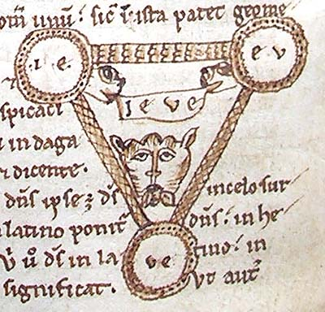
The Occult Philosophy Appears
Magia is underwritten by the Divine Name(s), Symbolae and Sympatheia
The Divine Names YH(Sh)VH is the operative power of Ontological Creativity
From it are derived all other Divine Names of Power, including Angelic/Demonic names
From the Divine Mind first emerge Symbolae - Geometry, Symbols, Letters, Words, Language
Some languages are ontological more powerful than other given their proximity to divinity, e.g., Hebrew
Terrestrial reality are extensions of these divine Symbolae and are connected via occult Sympathetic/Antipathetic relations

Slide 51
The Occult Philosophy Appears
The task of the Magus is to discover the occult connections between entities which exist in the divine mind
Because those connections exist in the divine mind they can be instrumentalized by the human mind if illuminated by the divine mind
This is most obvious in instrumentalizing natural occult causation, i.e., magnetism
The illuminated mind can also render causation via the mind and imagination, just as the Divine mind
The vehicle of this causation is through Divine Name(s) and Symbolae - Geometry, Symbols, Letters, Words, Language

Slide 52
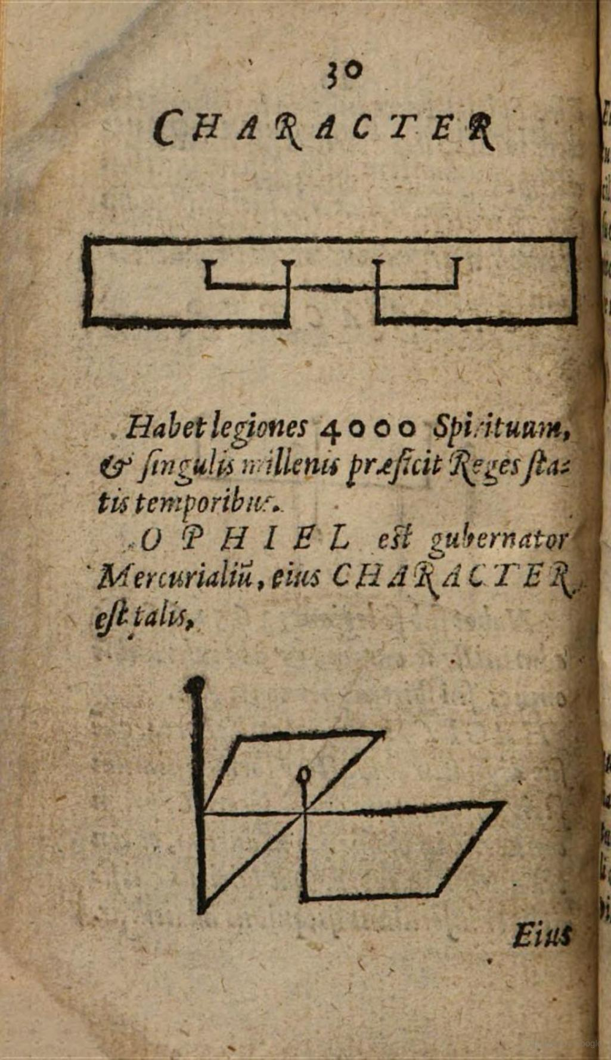
The Occult Philosophy Appears
These Symbolae have the ability to manipulate the natural world, including other people, capture celestial powers and hail super-celestial entities
One can hail but not compel spiritual entities, contra Solomonic Magic, but Agrippa isn’t consistent on this
The use of their Name via the Divine Name seems to allow the Magus to compel them
Perhaps this compulsive power isn’t binding but merely suggestive?

Slide 53
The Occult Philosophy Appears
Of central importance in the Symbolae are Incantations and Numbers
Incantations are strings of power vocal symbolae which imitate divine creative speech
That creative speech has the ability to manipulate reality directly
Mathematics is perhaps even more powerful, structures celestial reality
Through mathematics one can even more profoundly affect reality, e.g., engineering and music
Symbols have greater power as geometry is closer to the divine mind, c.f., Plato
This is why such symbols, i.e., sigils, are effective in celestial and super-celestial matters

Slide 54
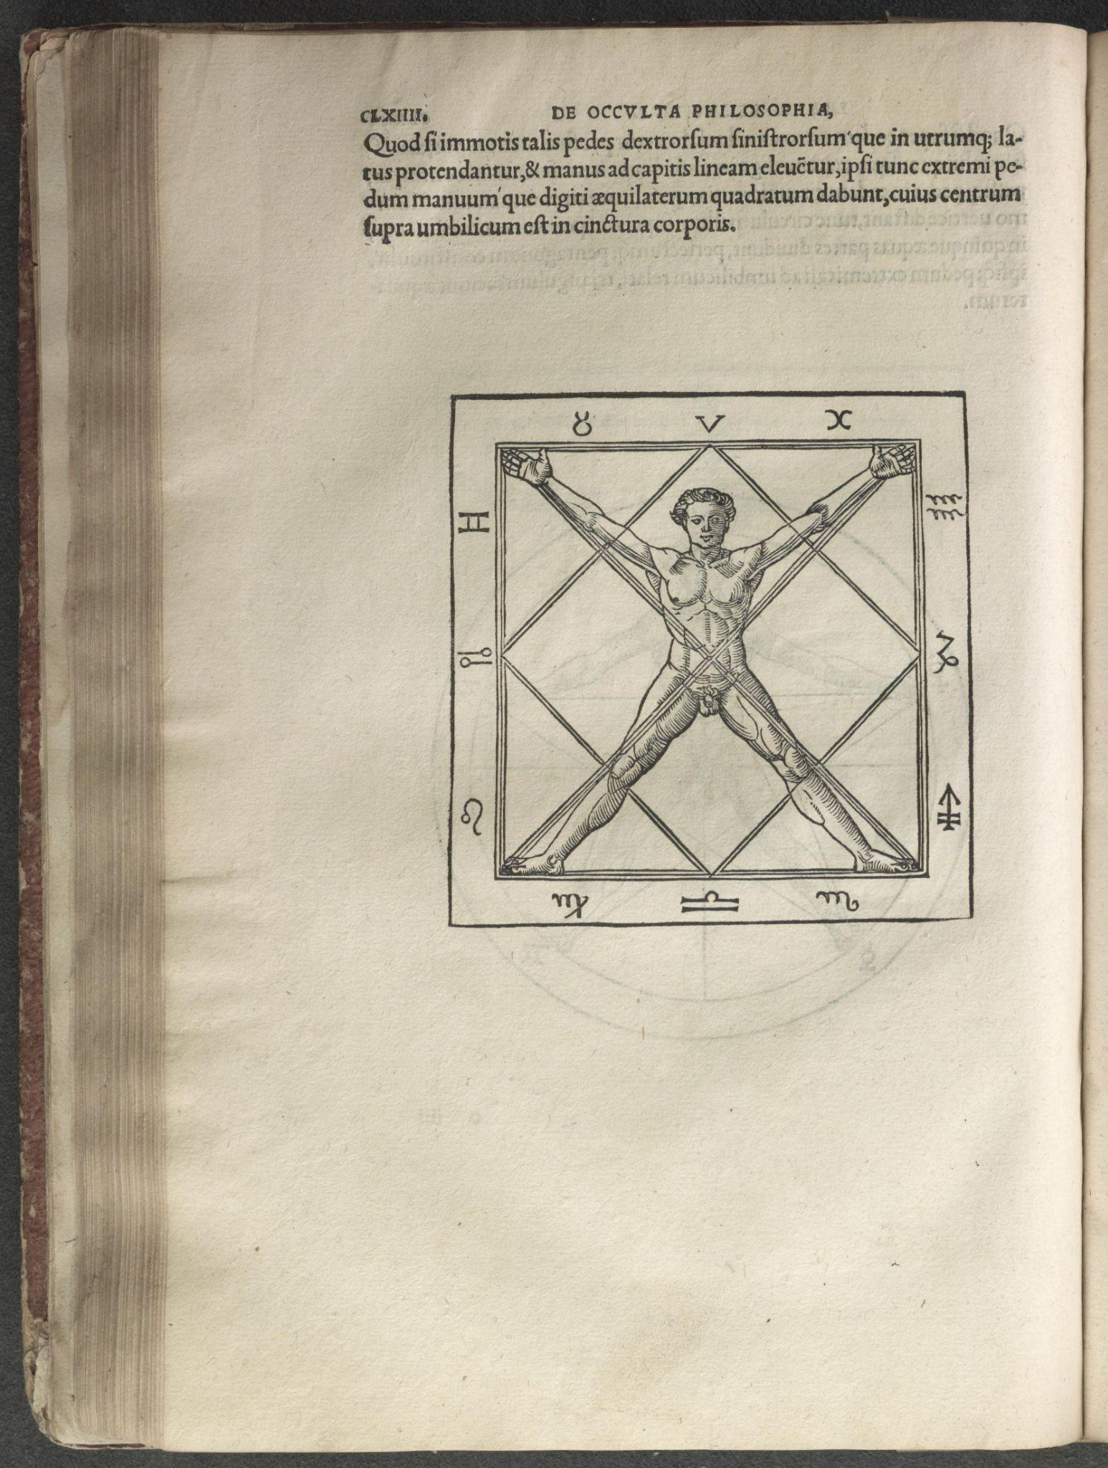
The Occult Philosophy Appears
The inherent power of these Sigils can be dangerous
They inherently attract spiritual entities, including evil entities
This hailing beacon sets one up for demonic seduction
BUT, does not give one binding power over such entities
The Illumination problem again - Are the Sigils powerful on their own without Illumination? Agrippa fundamentally wavers on this position
Regardless, at the center of this is the Human Being, the “knot of the cosmos”

Slide 55
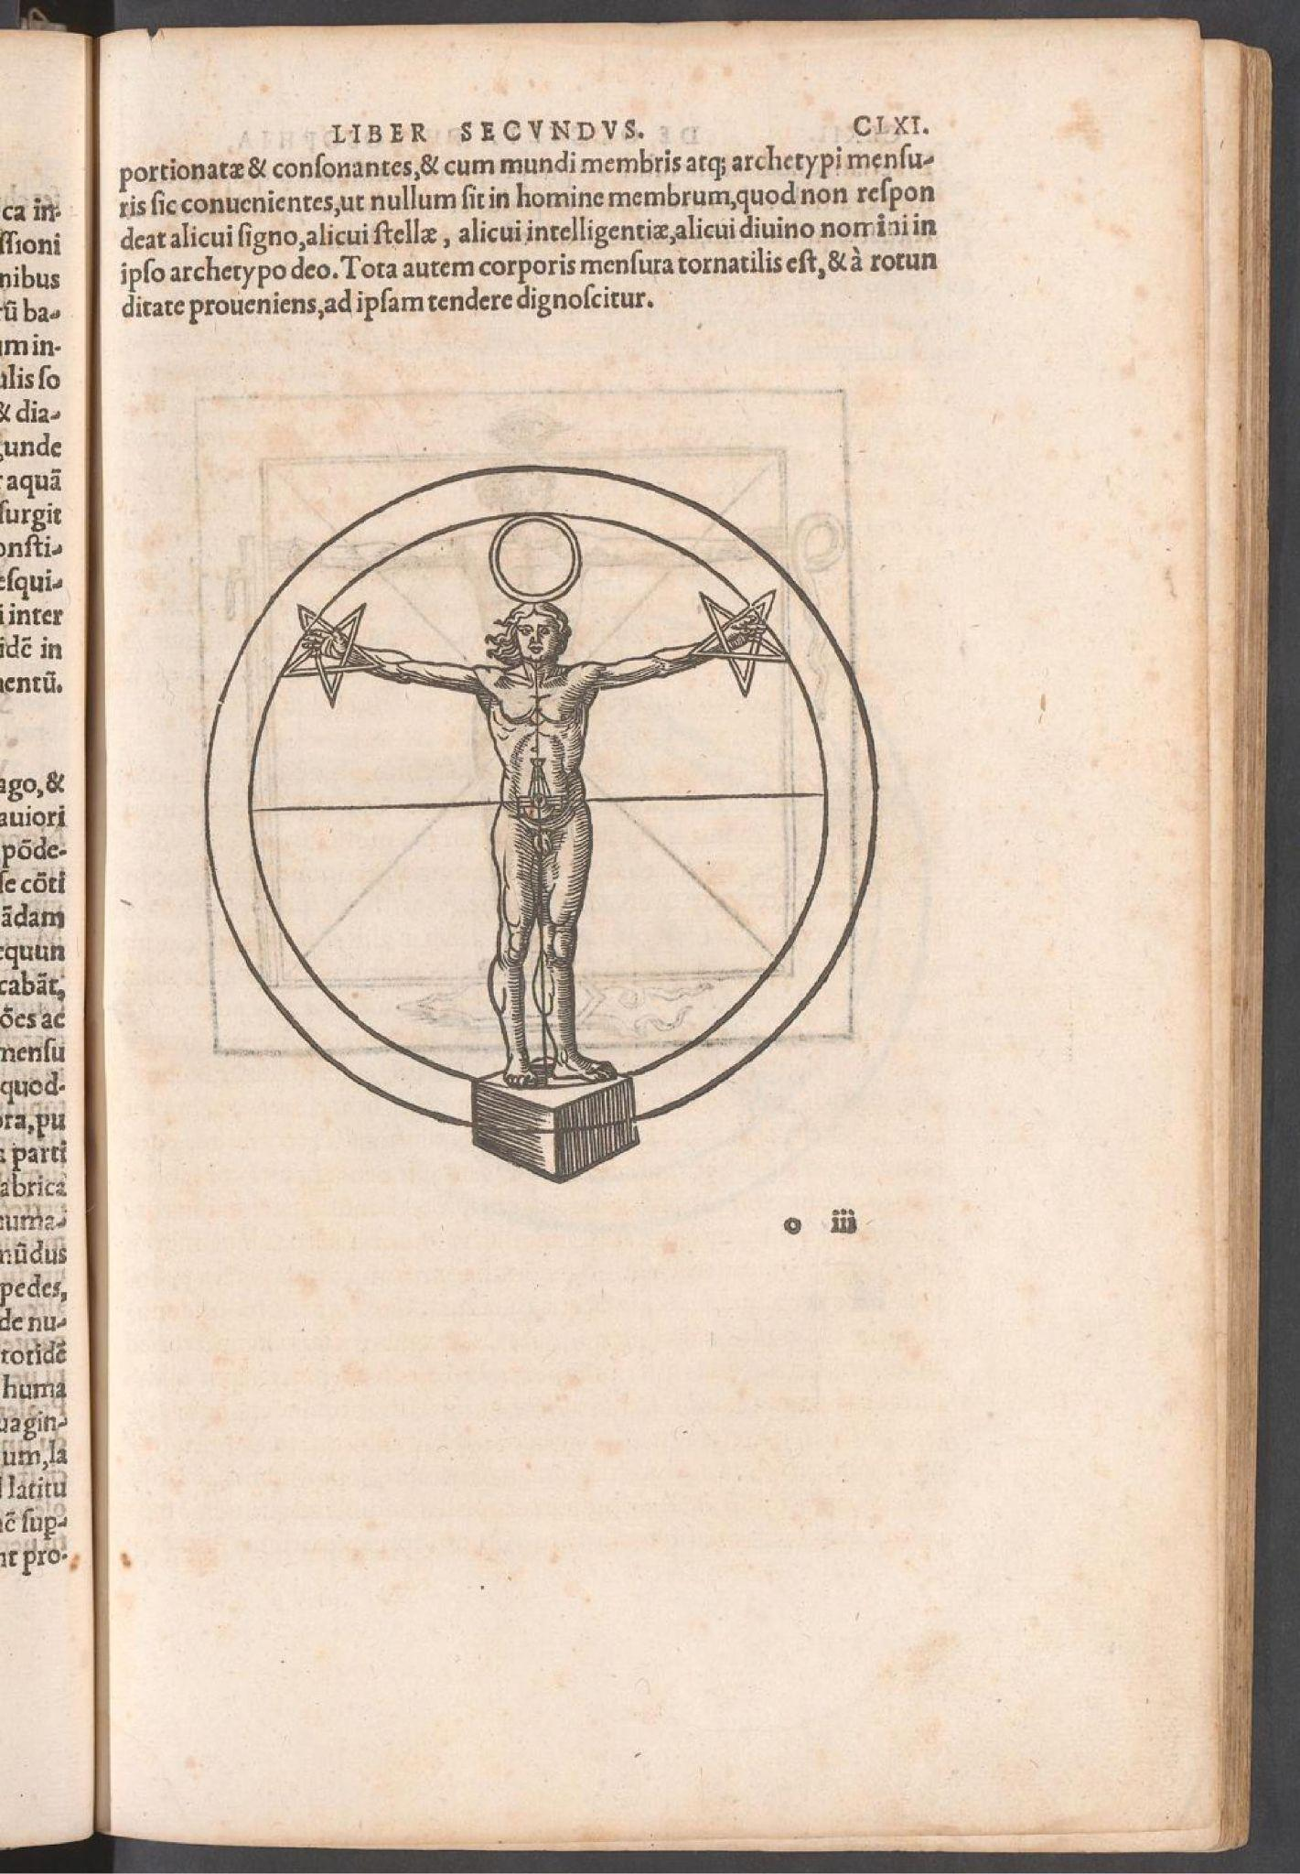
The Occult Philosophy Appears
At the core of Agrippa’s occult worldview is the human being
The human being is the “knot of the cosmos,” the microcosm in the fullest sense
Composed of Body, Mind and Soul corresponding to the Terrestrial, Celestial and Divine Worlds
The exhalation of the human through magic makes them the master of the terrestrial, free of astral domination and in re-union with the Divine having been made in the divine image
But the fall has made the human being merely corporeal, a mind clouded and a spiritual alienated from the divine
At the core of the mechanics of magic is the human soul/mind/body

Slide 56
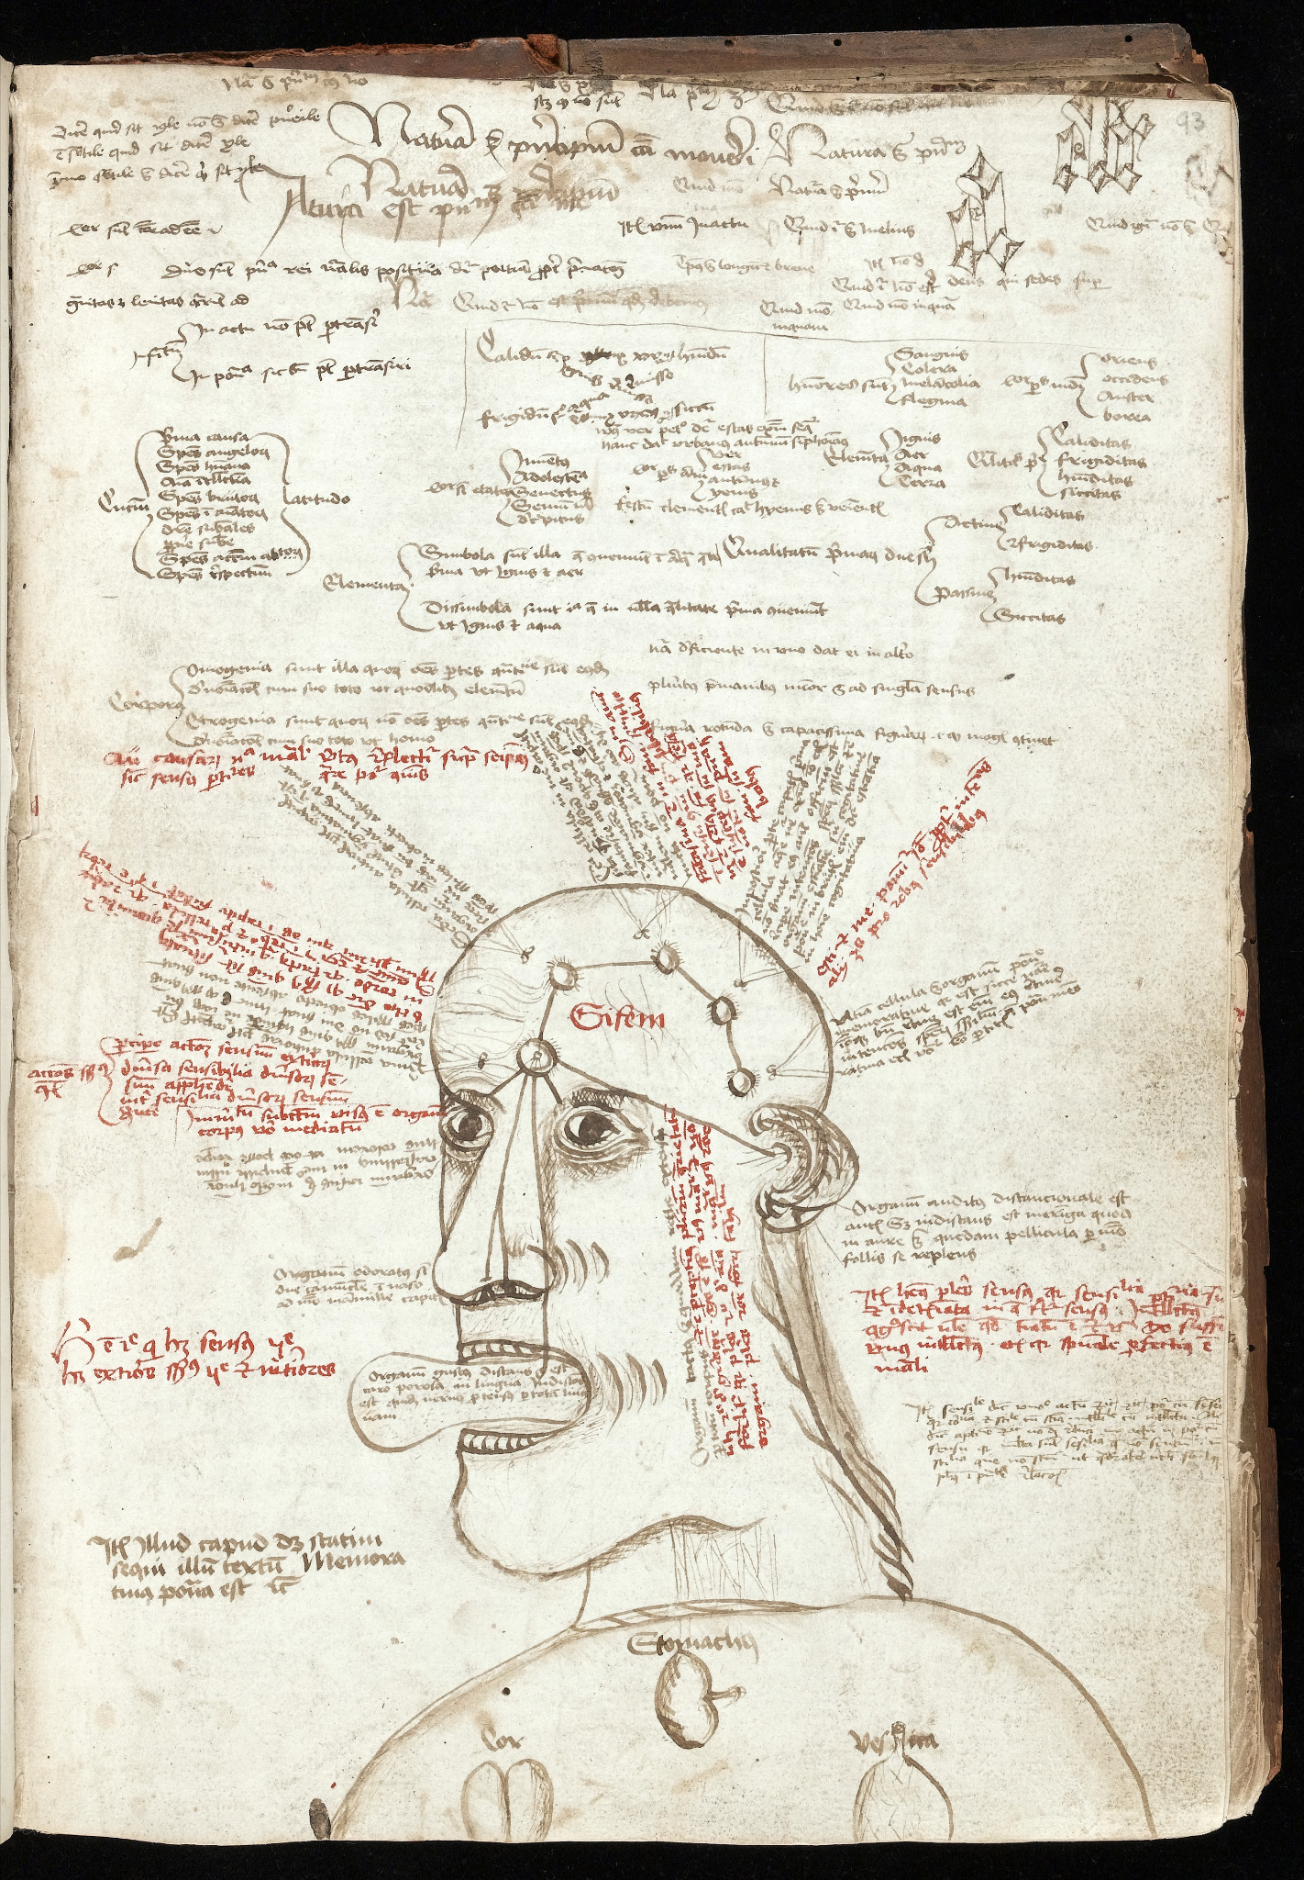
The Occult Philosophy Appears
Soul/Mens/Intellect - directly connected to the Divine, subject to Illumination and only acts when illuminated, necessarily survives death (Averroism?)
Ratio - The “mind” fallen and subject to error and fate, unless aided and informed by the illuminated Mens, subject of afterlife (can become a ghost)
Idolum - The Imaginative and Cognitive centers, probably subject to fate, perishes at death
Body - Subject to fate
The task of Magic is to allow the Illumined Mens to instruct Ratio as expressed in Imagination and Cognition while Embodied thus re-uniting the Macrocosm with the Microcosm
This completed circuit is the Dignified Human Being

Slide 57
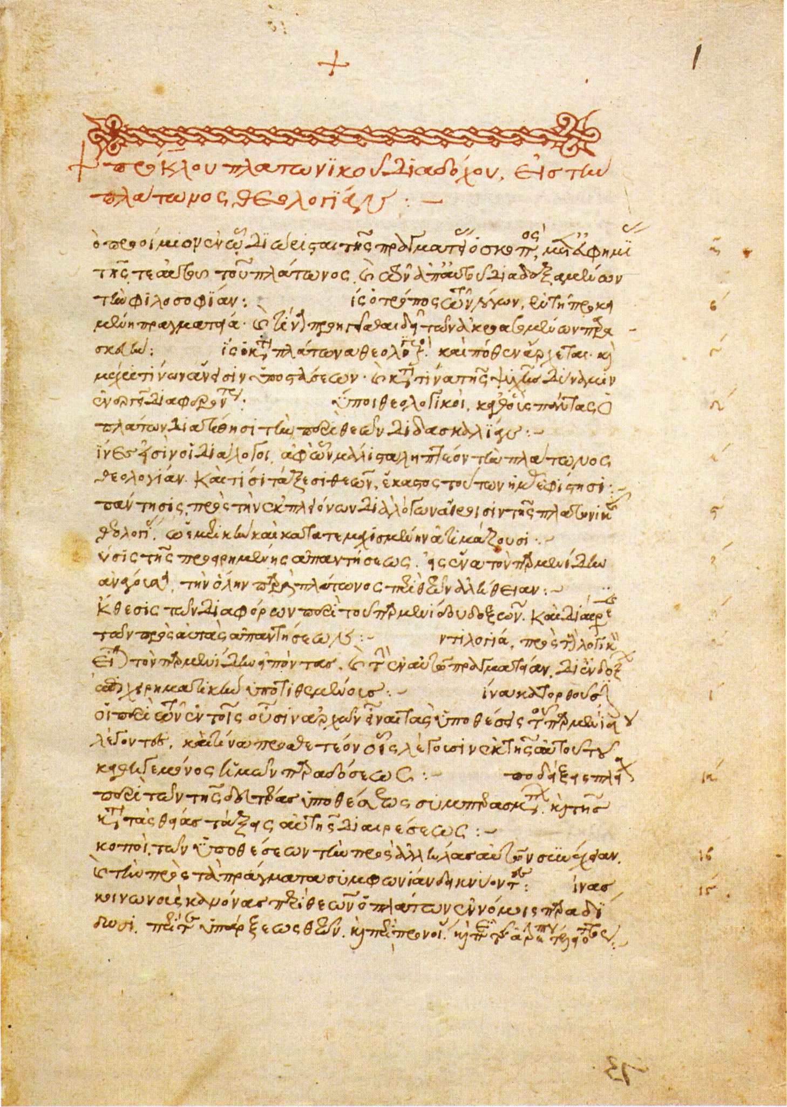
The Occult Philosophy Appears
Agrippa also employs the Neo-Platonic concept of the Aethereum Animae Vehiculum along with the Spiritus of Ficino
The AAV is the medium by which the divine diffuses the soul through the body, originating in the heart
It is coterminous with the body, carries the Mens (and blessed Ratio) back to the divine at death
Perhaps made of some spiritual, ethereal substance and (dangerously) tied with metempsychosis
Spiritus is the medium which connects the soul to the body
It is also the medium through which transitive magic causally flows
Spiritus can interact with both the soul and the body, e.g., the Evil Eye

Slide 58
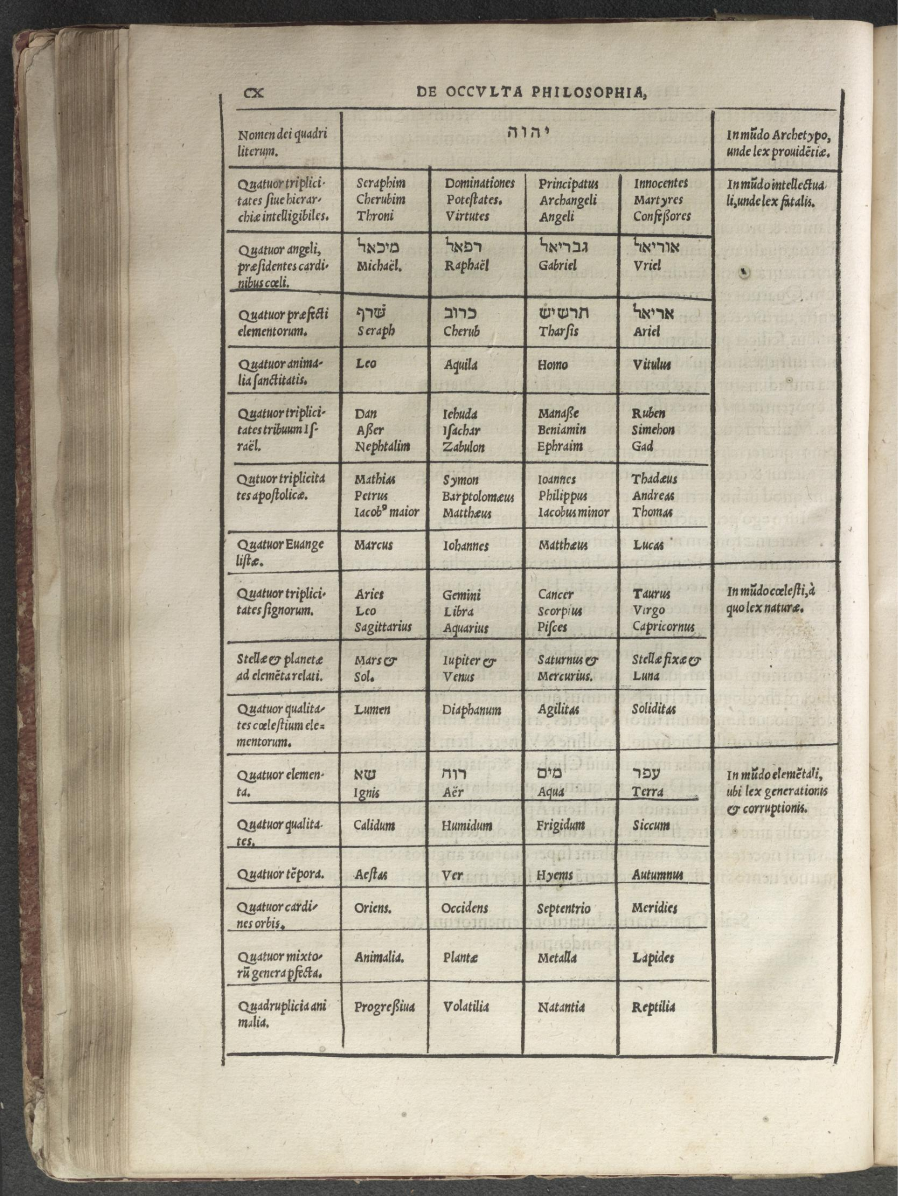
The Occult Philosophy Appears
Illumination seems to originate in the Divine, proceed to the Celestial realm and thus to the human being
Thus there is a greater and lesser Illumination: Divine - Angelic - Celestial
If the Illuminated Mens rightly guides the Ratio, the originator of that Illumination bequeathed those specific powers onto the recipient
The ability of the recipient of Illumination to impress their will upon exterior reality, e.g., magic, is typically denoted at Ligatio
Just as the human being is the ‘knot’ of the world they can also have the power to be the tier of metaphysical knots between the Sympathies

Slide 59
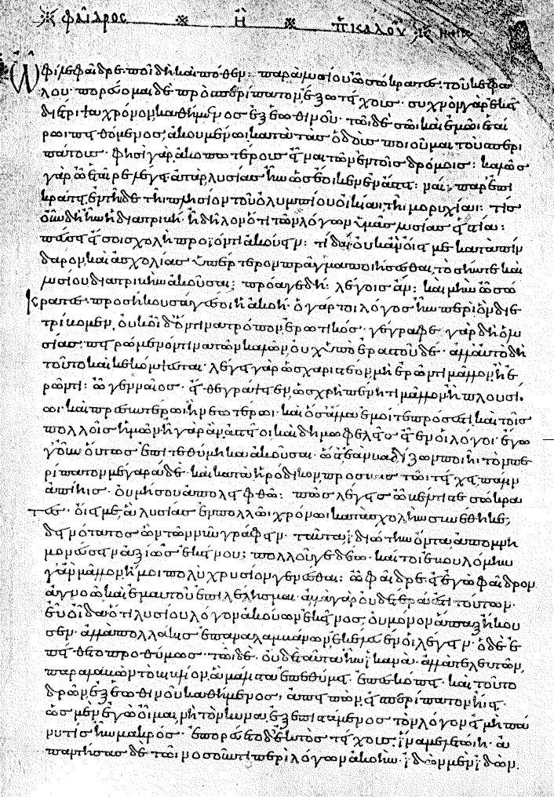
The Occult Philosophy Appears
Further, because the mens is directly connected to the Divine (and the Spiritus is connection to the World Spirit) this allow the properly Illuminated Mens-Ratio to have access to future events via Prophecy, c.f., Maimonides
This prophetic inspiration will, by logical and metaphysical necessity interact with Astrology, the science of fate
The three forms of the specific form of Celestial Illumination are Frenzy (furor), Ecstasy/Rapture and Dreams

